Slide 1
Latest results from ARGO-YBJ
P. Camarri
University of Roma “Tor Vergata”
And
INFN Roma Tor Vergata

Slide 4
Outline
Physics motivations
Layout
Detector performance
Physics results (old and new ones)
Summary

Slide 6
Experimental Hall

Slide 7
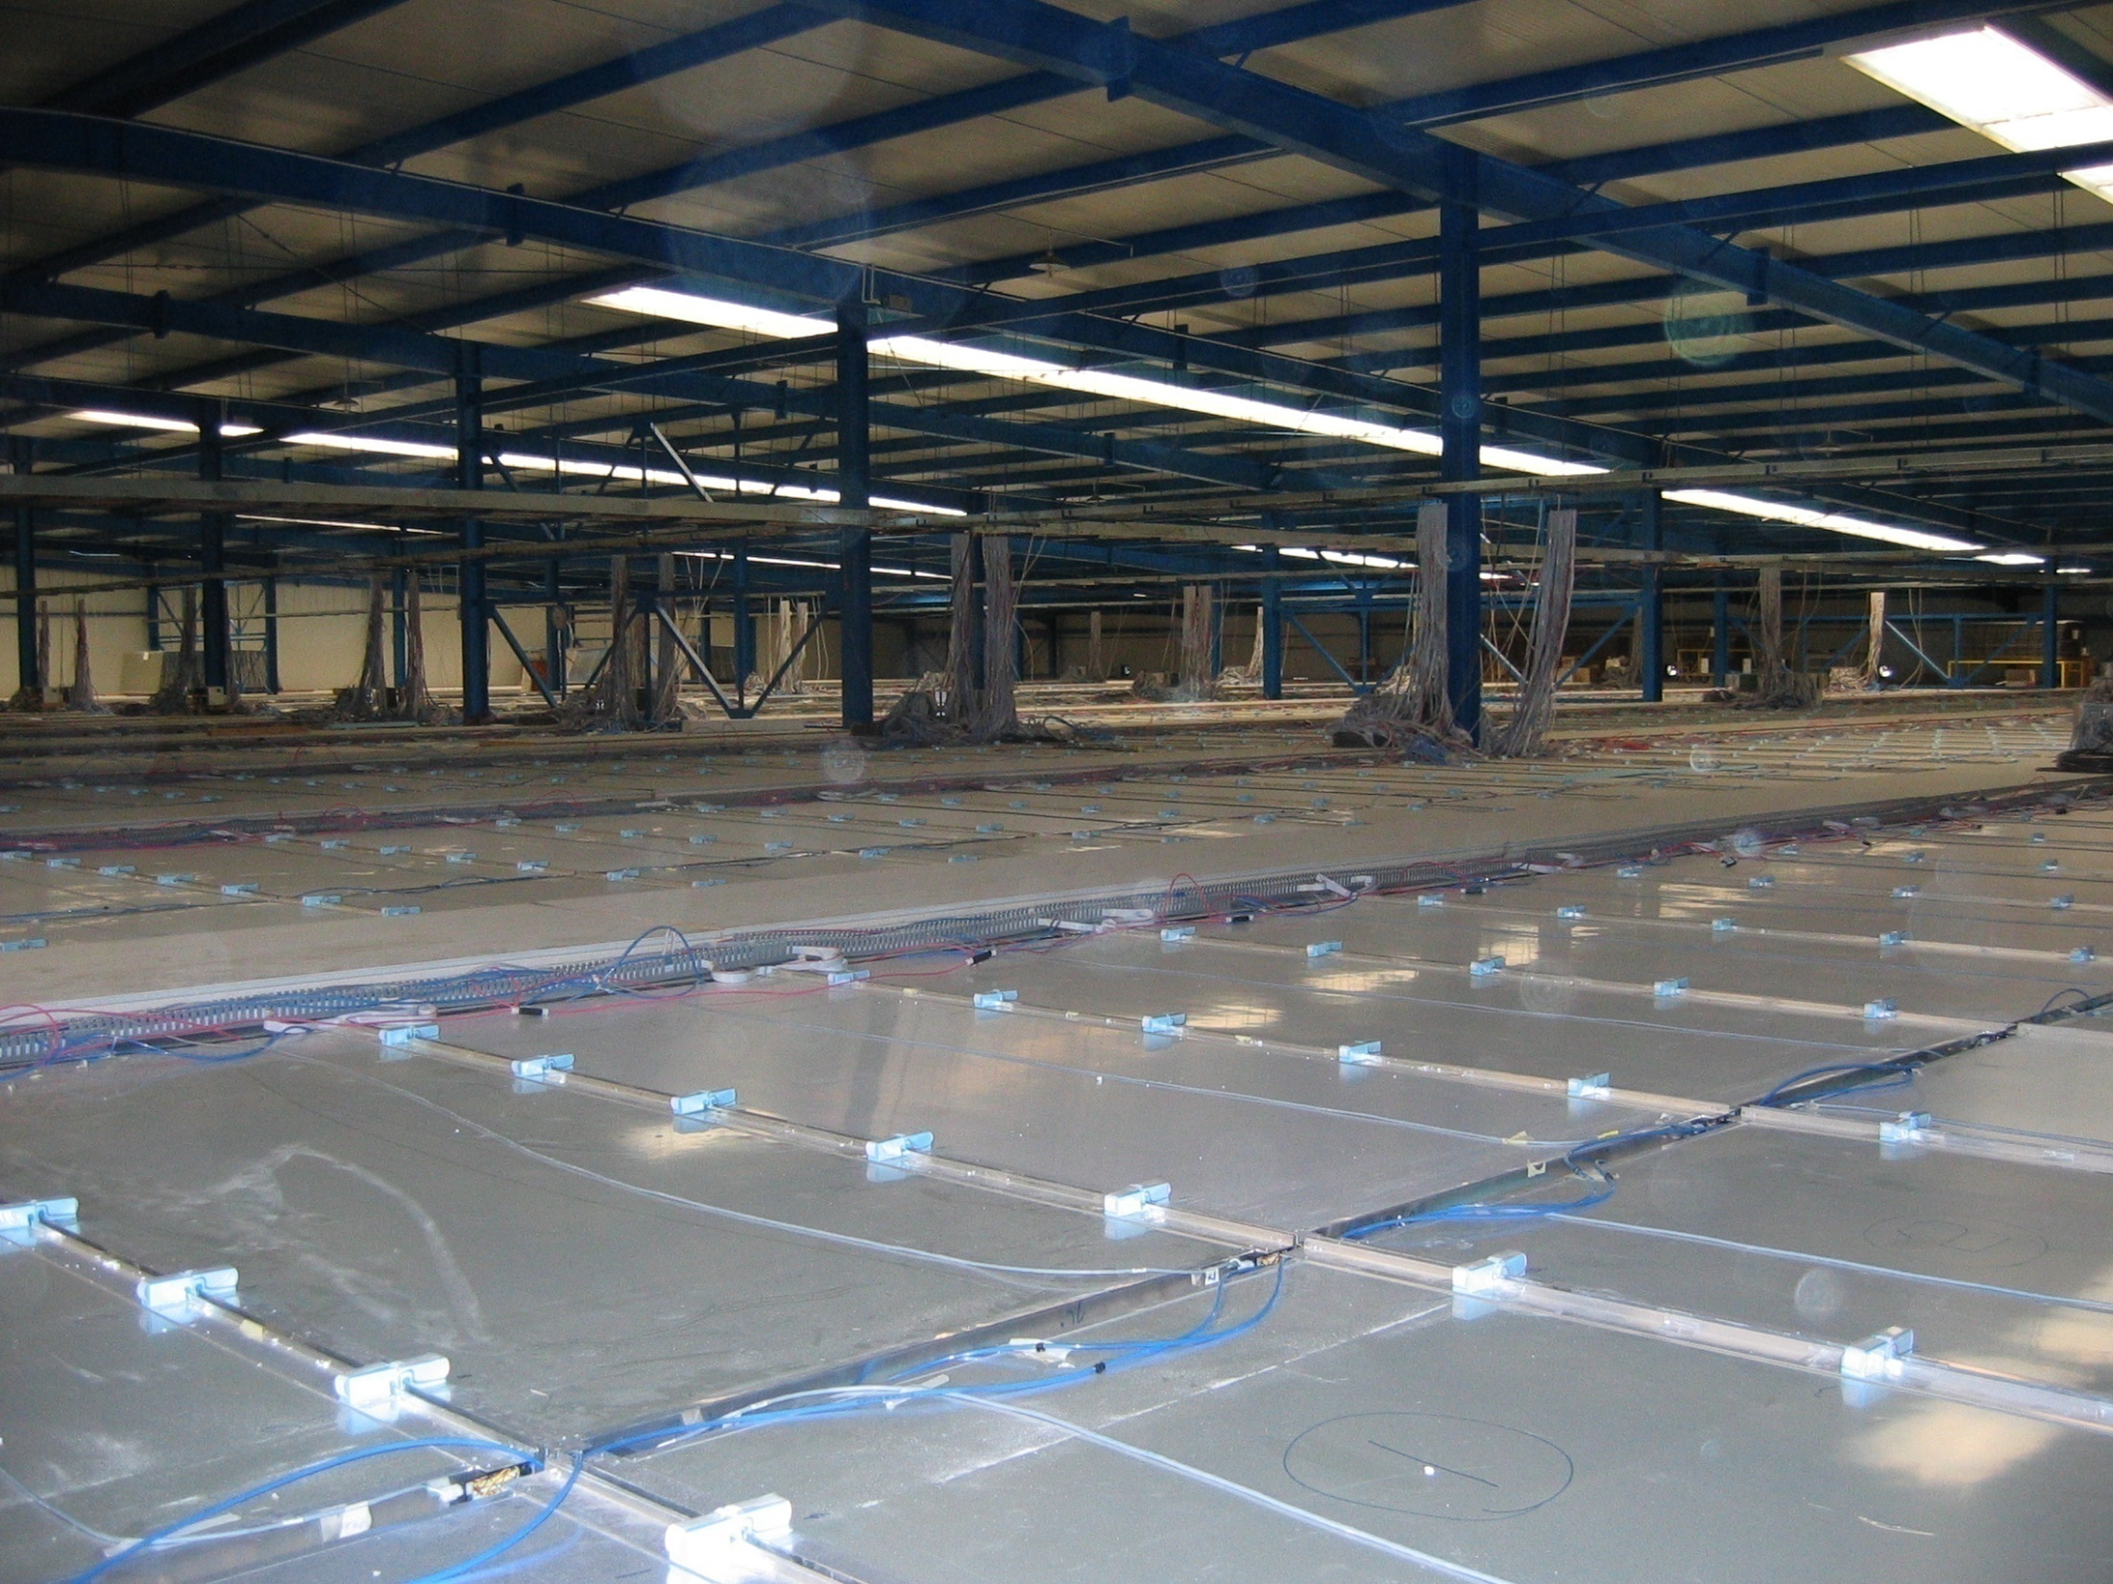
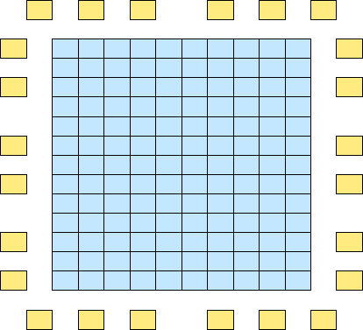
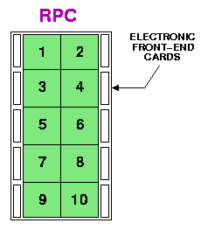
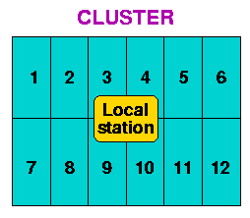
Experimental Hall & Detector Layout
time resolution ~1-2 ns (pad)
space resolution = strip
Central Carpet:
130 Clusters
1560 RPCs
124800 Strips
99 m
74 m
8 Strips
(6.5 x 62 cm²)
for each Pad
10 Pads
(56 x 62 cm²)
for each RPC
1 CLUSTER = 12 RPCs
(5.7 × 7.6 m²)
78 m
RPC
Gas Mixture: Ar/ Iso/TFE = 15/10/75
HV = 7200 V
111 m
Single layer of Resistive Plate Chambers (RPCs)
with a full coverage (92% active surface) of a large area (5600 m²)
+ sampling guard ring (6700 m² in total)

Slide 8
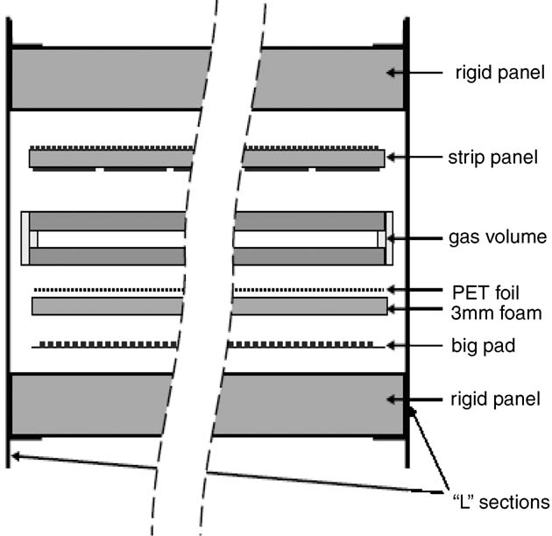
The ARGO-YBJ Resistive Plate Chambers
Gas mixture:
C₂H₂F₄/Ar/iC₄H₁₀ = 75/15/10
Operated in streamer mode
Time resolution ~ 1.5 ns

Slide 9
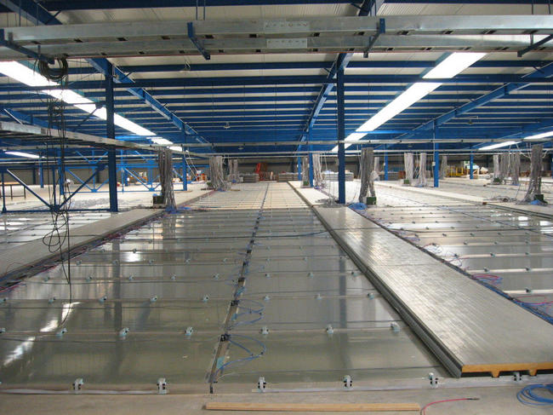
Detector Pixels
Strip =SPACE PIXEL, 6.5 x 62 cm², 124800
Pad =TIME PIXEL, 56 x 62 cm², 15600
BigPad =CHARGE readout PIXEL, 120 x 145 cm², 3120
Cluster = DAQ unit = 12 RPCs
σ_{t}≈1 ns
BigPad
Pad
RPC
Strip

Slide 11
Operational Modes
Shower Mode:
Detection of Extensive Air Showers (direction, size, core …)
Coincidence of different detector units (pads) within 420 ns Trigger : ≥ 20 fired pads on the central carpet (rate ~3.6 kHz)
Object:
Cosmic Ray physics (above ~1 TeV)
VHE γ-astronomy (above ~300 GeV)
INDEPENDENT DAQ
Scaler Mode:
Recording the counting rates (N_{hit} ≥1, ≥2, ≥3, ≥4) for each cluster at fixed time intervals (every 0.5 s) lowers the energy threshold down to ≈ 1 GeV. No information on the arrival direction and spatial distribution of the detected particles.
Object:
flaring phenomena (high energy tail of GRBs, solar flares)
detector and environment monitor

Slide 12
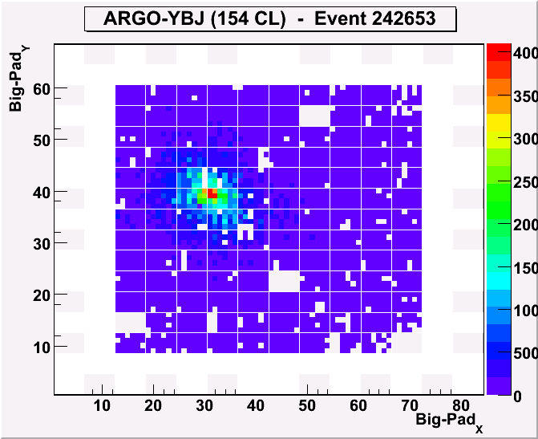
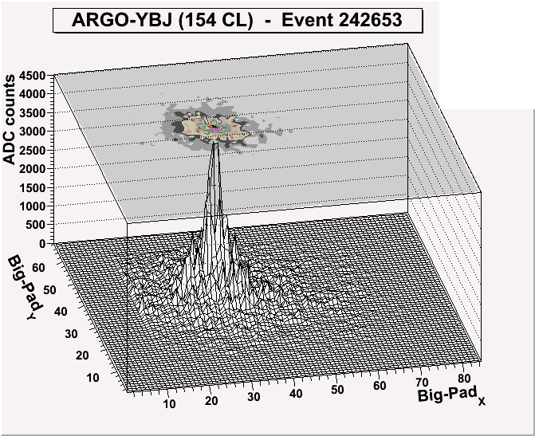
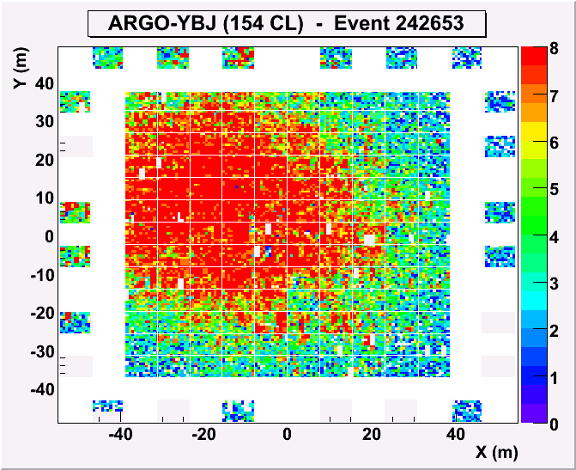
Analog read-out
Is crucial to extend the dynamics of the detector for E > 100 TeV, when the strip read-out information starts to become saturated.
Max fs: 6500 part/m²
0
4000
0
3500
3000
2500
ARGO event
2000
1500
1000
500
Fs: 4000 -> 1300/m²

Slide 15
Stability
Monitored in time using the following information:
Trigger rate
Particle-multiplicity distribution
Angular distribution

Slide 16
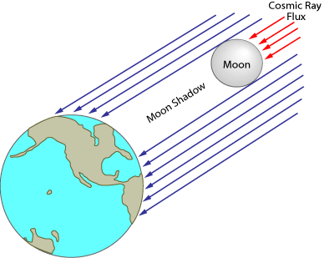
The Moon Shadow technique
Cosmic rays are blocked by the Moon
Deficit of cosmic rays in the direction of the Moon
Size of the deficit
Position of the deficit
Angular Resolution
Pointing Error
Geomagnetic Field: positively charged particles are deflected towards the West.
Ion spectrometer
Moon diameter ~0.5 deg
The observation of the Moon shadow may provide a direct check of the relation between size and primary energy
West displacement
Energy calibration

Slide 19
γ-ray astronomy
Crab Nebula
Mrk 421
MGRO 1908+06
Cygnus region
and more…
no γ/h discrimination applied so far

Slide 20
γ/h discrimination
Some algorithms developed based on
2-D topology
Time profile
Time distribution
Q factor = 1.2 - 3 depending on the number of fired pads
Very heavy, fine tuning needed
Many months for data reprocessing

Slide 45
Cosmic Ray Physics
Spectrum of the light component (1-100 TeV)
Medium and large scale anisotropies
The anti-p/p ratio

Slide 55
(under peer reviewing for publication on PRD)

Slide 59
ATEL #3801
Title: ARGO-YBJ detects a VHE gamma-ray flare from Mrk501.
Author: The ARGO-YBJ Collaboration
Posted on: Dec 9th, 2011
We report on the observation of a strong gamma-ray flare from Mrk501 at
energies above 300 GeV by the ARGO-YBJ experiment, following the discovery
by MAXI/GSC (ATEL #3752) of X-ray brightening starting on November 1, 2011.
According to the Swift/BAT light curve at 15-50 keV, this flare started
on October 17 and lasted at least until December 9. Integrating the flux
from Mrk501 detected by ARGO-YBJ over the period from October 17 to November
21 (more data are still in analysis), an excess with statistical significance
of 6.1 standard deviations is found. The average flux is about 3 Crab-unit.
From November 1 to November 13, when Swift/BAT measured the peak flux,
the ARGO-YBJ data show an excess with statistical significance of 4.8 standard
deviations from Mrk501, indicating that the flux is enhanced by a factor
of 10, corresponding to a flux of about 4 Crab-unit.
The observed flare is probably the strongest outburst from Mrk501 since
its last huge emission observed in 1997. Multiwavelength observations of
this source are encouraged.
ARGO-YBJ is a full-coverage air-shower detector located at the Yangbajing
Cosmic Ray Laboratory at 4300 m a.s.l. in Tibet, China. With an energy
threshold of a few hundred GeV, the detector has a field of view of about
2 sr and a duty cycle of about 90%, which allow a continuous monitoring
of a large part of the sky. The Mrk501 region is observed for about 6 hours
every day. The monitoring of the Mrk501 by ARGO-YBJ is still under way
and the analysis with more data is in progress.

Slide 60
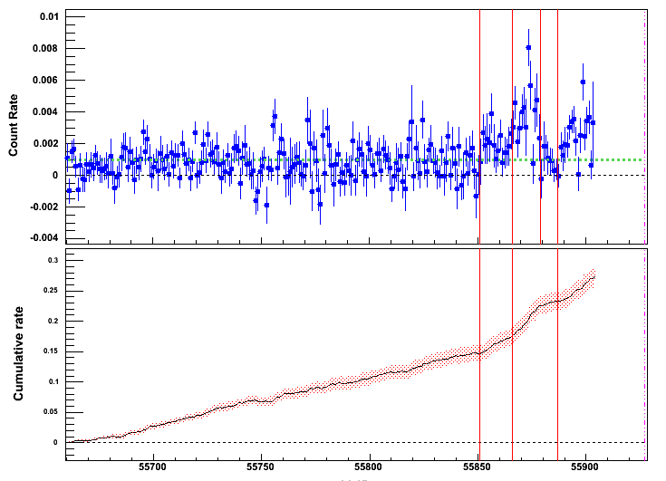
Swift 15-50keV
Flaring: 2011-290 to 325
Large flare: 2011-304 to 317

Slide 61
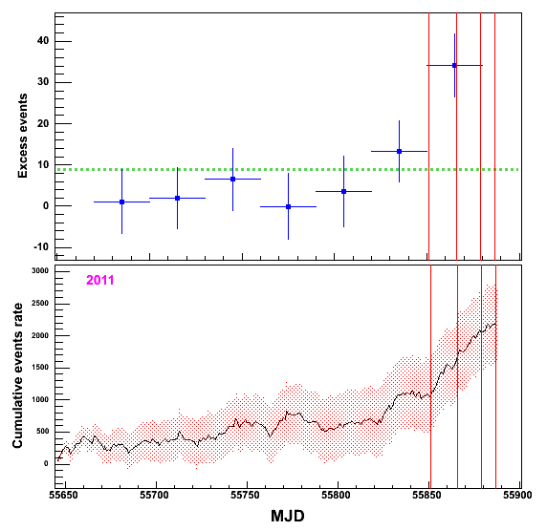
ARGO-YBJ result (very preliminary)

Slide 62
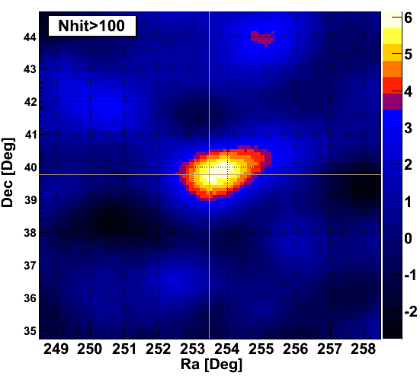
ARGO-YBJ result (very preliminary)
2011-290 to 325, S_{max}=6.14σ
The flux ~ 3 Crab

Slide 63
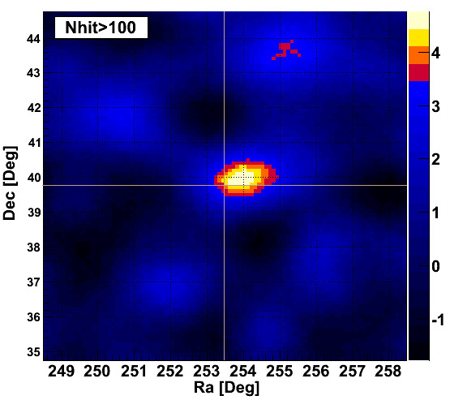
ARGO-YBJ result (very preliminary)
Large flare: 2011-304 to 317, S_{max}=4.76σ
The flux increased a factor of 10 times. ~4 Crab

Slide 64
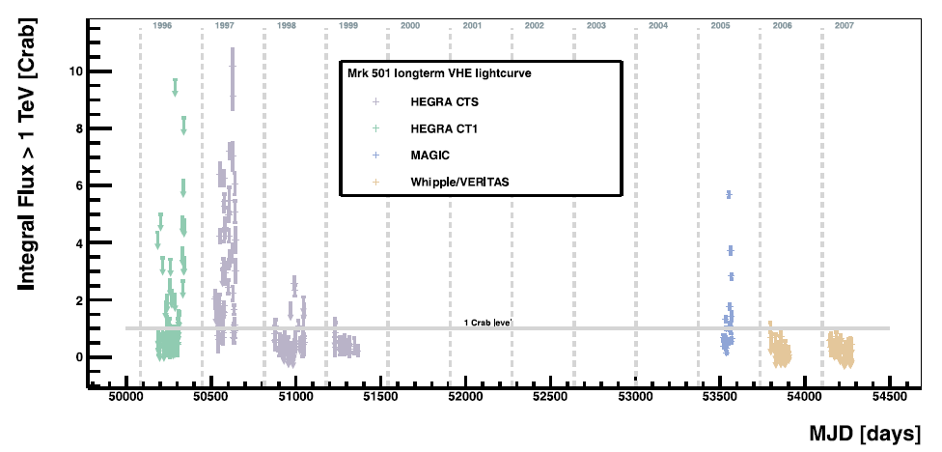
Mrk501 long-term curve at VHE

Slide 65
Summary (1)
excellent detector performance
smooth running of the experiment with good parameters
duty cycle 85%
trigger rate 3.5 kHz
dead time 4%
minimum shower size 20 particles
imaging of the shower front successfully implemented

Slide 66
Summary (2) Results of 3 years of ARGO-YBJ observations
Detailed analysis of the Moon shadowing effect
Long-term monitoring of Crab and Mrk421
Correlation of TeV γ-ray emission with X-ray and MeV emission from Mrk421 and Mrk501 AGNs
Integrated sensitivity: 0.3 Crab units
2 MILAGRO sources observed above 5 s.d. (MGRO J1908+06, MGROJ 2031+41)
No positive detection of MGRO J2019+37
Fluence upper limits on 110 GRBs (ΔE=1-100GeV)

Slide 67
Summary (3) Results of 3 years of ARGO-YBJ observations
Measurement of the CR light-component energy spectrum below 100 TeV
Study of the CR anisotropy at different angular scales
Measurement of the CR anti-p/p flux ratio in TeV energy range
Monitoring of the IMF transverse component by the Sun-shadow N-S displacement
Measurement of the p-air and pp cross sections up to 100 TeV

Slide 68
Summary (4)
Data taking planned until December 2012
Updating current results
Data reprocessing with γ/h discrimination
Extending the energy range to the knee region by the charge readout
light-component energy spectrum
p-air and pp cross sections

