Slide 1
TeV Neutrinos and Gamma rays from Pulsars/Magnetars
Arunava Bhadra
High Energy & Cosmic Ray Research Ctr.
North Bengal University

Slide 2
Introduction
The energy spectrum of cosmic rays extends to extremely high energies, values exceeding 10²⁰ eV.
The origin of the cosmic rays and the mechanism responsible for acceleration of cosmic rays to such high energies are still not known conclusively.
It is generally believed that the cosmic rays below around 10¹⁸ eV are of galactic origin whereas those having energies above this energy are extragalactic.
The potential galactic candidate sources:
  The remnants of supernova explosions
  Pulsars
  Magnetars

Slide 3
Looking for the sources of cosmic rays
Being dominantly charged particles, cosmic rays are deflected by cosmic magnetic fields and hence they don’t point back to it source.
Cosmic rays of high energies are likely to generate a large associated flux of gamma rays in interactions with the ambient matter and the radiation fields.
Being neutral, each γ-ray points directly back to it source thereby giving an opportunity to identify the sources of cosmic rays.

Slide 4
The recent success of satellite/ground-based very-high-energy γ -ray telescopes has opened a new window on the most powerful and violent objects of the Universe.
Several TeV gamma ray sources are known now.
However, gamma rays are also produced as a result of
  electron bremsstrahlung
  Inverse Compton effect of electrons scattering soft photons
The detection of gamma rays is not a clear evidence for the acceleration of hadrons.
Neutrinos are produced in high-energy hadronic processes.
Thereby neutrinos allow a direct detection and unambiguous identification of the sites of acceleration of high-energy baryonic cosmic rays.

Slide 5
Pulsars/Magnetars as strong neutrino source
Recently Magnetars (Zhang et al ApJ 2003) and Pulsars (Link and Burgio PRL 2005; MNRAS 2006) have been proposed as potential strong sources of TeV neutrinos.
Protons or heavier ions are accelerated near the surface of the pulsar/Magnetar by the polar caps to PeV energies.
Accelerated ions interact with the thermal radiation field of pulsar resulting occurrence of Δ resonance state provided their energies exceed the threshold energy for the process.
Muon neutrinos are subsequently produced from the decay of Δ particles.

Slide 6
Link and Burgio (PRL 2005, MNRAS 2006) estimated the neutrino event rate to be observed by a neutrino telescope alike to ICECUBE from pulsars, if cosmic rays are accelerated up to PeV energies in pulsar environment .
Non-observation of any pulsar (precisely no point source) in the TeV energy scale by the AMANDA-II neutrino telescope [PRD 2009].
ICECUBE not seen any diffuse emission (PRD 2011)
Should we still consider pulsars as the potential source of cosmic rays at least in the PeV energy regime?
Here we will revisit the issue of the neutrino event rate at earth from pulsars.

Slide 7
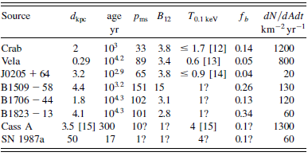

Slide 8
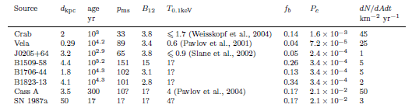

Slide 10
Presence of a hadronic component in the flux of pulsar accelerated particles should result in the emission of high-energy neutrinos and gamma-rays simultaneously.
both charged and neutral pions are produced in the interactions of energetic hadrons with the ambient photon fields surrounding the acceleration region.
Constraint from gamma ray observation –
  Some idea about the expected neutrino flux should be readily available from the gamma ray observations.

Slide 11
Models for acceleration of particles by pulsars/Magnetars
The Polar gap model (Ruderman & Sutherland 1975)
  acceleration of particles takes place in the open field line region above the magnetic pole of the neutron star.
The Outer-gap model (Cheng, Hu, Ruderman 1986)
  acceleration occurs in the vacuum gaps between the neutral line and the last open line in the magnetosphere.

Slide 12
The Polar gap model
Acceleration of particles takes place in the open field line region above the magnetic pole of the neutron star.
Particles are extracted from the polar cap and accelerated by large rotation-induced electric fields, forming the primary beam.
the region of acceleration in the polar-gap model is close to the pulsar surface
Two possibilities
electron may be accelerated
or may lead acceleration of positive ions

Slide 13
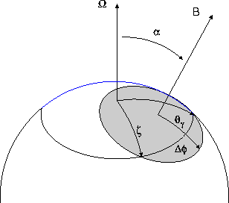

Slide 14
The maximum potential drop that may be induced across the magnetic field lines between the magnetic pole and the last field lines that opens to infinity
Δϕ=B_{s}R_{S}³Ω²/2c²
B_{S} is the strength of magnetic field at neutron star surface
R_{S} is the radius of the neutron star
Ω is the angular velocity
For young millisecond pulsar with high magnetic fields
Δϕ ~ 7 × 10¹⁸ B₁₂P_{ms}⁻²
B_{S}=B₁₂ × 10¹² G, P_{ms} is the pulsar period in millisecond.

Slide 15
Let us conjectured that protons or heavier ions are accelerated near the surface of a pulsar by the polar caps to PeV energies (correspond to small screening) when
μ · Ω < 0
(such a condition is expected to hold for half of the total pulsars).
When pulsar-accelerated ions interact with the thermal radiation field of pulsar, the Δ-resonance state may occur provided their energies exceed the threshold energy for the process.

Slide 16
The threshold condition for the production of Δ-resonance state in pγ interaction is
ε_{p}ε_{γ}(1-cosθ_{pγ}) ≥ 0.3 GeV²
ε_{p} Proton energy, ε_{γ} photon energy
θ_{pγ} angle between proton and photon in the Lab frame.
The energy of a thermal photon near the surface of the neutron star is
2.8 × kT_{S} (1+z_{g})
T_{S} is the surface temperature of Neutron star

Slide 17
The condition for the production of the Δ-resonance becomes
B₁₂ P_{ms}⁻²T_{0.1keV}≥ 3 × 10⁻⁴
T_{0.1keV} ≡ (kT_{S}/0.1 keV),
typical surface temperature of neutron star is 0.1 keV
Such a condition holds for many young pulsars, and thus Δ-resonance should occur in the atmosphere of many pulsars.

Slide 18

Gamma and Neutrino production
Gamma-rays and neutrinos are produced via Δ-resonance through the following channels
The charge-changing reaction takes place just one-third of the time,
On the average four high-energy gamma-rays are produced for every three high-energy neutrinos

Slide 19
The flux of gamma-rays and muon neutrinos from pulsars
The charge density of ions near the pulsar surface is
ρ_{q} = eZn_{GJ}
where n_{GJ} ≡ B_{s}R³Ω/(4πZecr³) is the Goldreich–Julian density at distance r
The charged particle density in the polar gap
ρ_{gap} = f_{d}(1-f_{d})n_{GJ}
f_{d} is the depletion factor (a model dependent quantity)
The flux of protons accelerated by a polar cap is
L_{PC} = cρ_{gap}A_{PC}

Slide 20
The area of the polar cap
A_{PC} ≡ 4ηπR_{S}²
η is the ratio of the polar cap area to the neutron star surface area.
The canonical polar cap radius is given by r_{PC} = R_{S} (ΩR_{S}/c)^{1/2} (Beskin et al. 1993),
η=ΩR_{S}/c
The protons accelerated by a polar cap will interact with the ther-mal radiation field of the neutron star.
the photon density close to the neutron star surface is
n_{γ}(R_{S}) = (σ/2.8k)[(1+z_{g})T_{S}]³
σ being the Stefan–Boltzmann constant.

Slide 21
Numerically n_{γ}(R_{S}) ~ 9 × 10¹⁹ T³_{0.1keV}
At radial distance r , the photon density will be
n_{γ}(r) = n_{γ}(R_{S}) (R_{S}/r)²
The probability that a PeV energy proton starting from the pulsar surface will produce Δ⁺ particle by interacting with thermal ﬁeld is given by (Link & Burgio PRL 2005)
P_{C} =1 -∫^{r}_{RS}P(r)dr
dP/P =- n_{γ}(r)σ_{Pγ}dr
The threshold energy for the production of Δ-resonance state in pγ interaction increases rapidly with distance from the surface of neutron star because of the (1-cosθ_{pγ})⁻¹ factor.

Slide 22
Requiring conversion to take place in the range R_{S} ≤ r ≤ 1.2R_{S} , P_{C} has been found to be ~ 0.02 × T³_{0.1keV}.
The total ﬂux of neutrino/gamma-ray generated in pulsar from the decay of Δ⁺ resonance is
L^{γ/ν}_{PC} = 2cξρ_{gap}A_{PC}P_{C}
ξ = 4/3 for photon
= 2/3 for mu-neutrino
The phase-averaged gamma-ray/neutrino ﬂux at the Earth from a pulsar of distance d is given by
J=2cζξηf_{b} f_{d}(1-f_{d})n_{GJ}(R_{S}/d)²P_{C}
f_{b} is the duty cycle of the gamma-ray/neutrino beam (typically f_{b} ∼ 0.1– 0.3)

Slide 23
ζ represents the effect due to neutrino oscillation
(the decays of pions and their muon daughters result in initial ﬂavour ratios φ_{νe} : φ_{νμ} : φ_{ντ} of nearly 1:2:0 but at large distance from the source the ﬂavour ratio is expected to become 1:1:1 due to maximal mixing of ν_{μ} and ν_{τ} .).
ζ = 1 and 1/2 for gamma-rays and muon neutrinos, respectively.
Average energy of the produced muon neutrinos would be 50 T⁻¹_{0.1keV,}
for gamma-rays ε_{γ} ~ 100 T⁻¹_{0.1keV,}

Slide 24
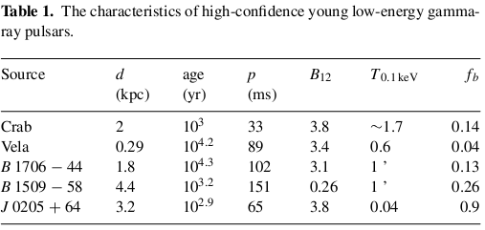
TEV GAMMA-RAYS FROM A FEW
POTENTIAL PULSARS

Slide 25
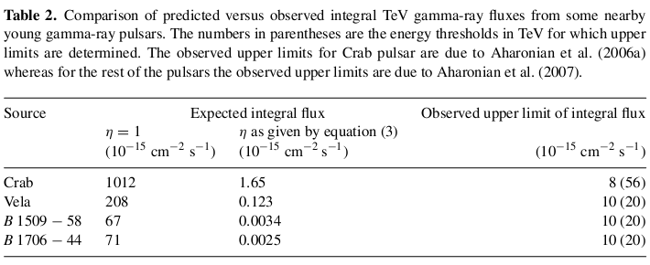

Slide 26
TeV neutrino from pulsars
The probability of the detection of muon neutrinos is the product of the interaction probability of neutrinos and the range of the muon
P_{ν→μ} ~ 1.3 × 10⁻⁶ (ε_{ν}/1 TeV)

Slide 27
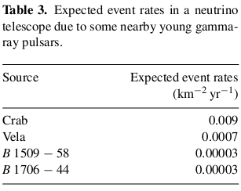

Slide 28
Gamma-rays and neutrinos from nebulae of young pulsars
The pulsar-injected ions of PeV energies should be trapped by the magnetic field of the nebula for a long period, and consequently there would be an accumulation of energetic ions in the nebula.
Energetic ions will interact with the matter of the nebula.
The rate of interactions (ψ) would be ncσ_{pA} ,where n is the number density of protons in nebula and σ_{pA} is the interaction cross-section.

Slide 29
If m is the mean multiplicity of charged particles in proton–ion interaction, then the flux of gamma-rays at a distance d from the source would roughly be
J_{γ} =2cβη f_{d}(1-f_{d})n_{GJ}(R_{S}/d)²mψt
β represents the fraction of pulsar-accelerated protons trapped in the nebula and t is the age of the pulsar.
Typical energy of these resultant gamma-rays would be ∼10³/(6 m) TeV where for (laboratory) collision energy of 1 PeV m is about 32 (Alner et al. 1987).

Slide 30
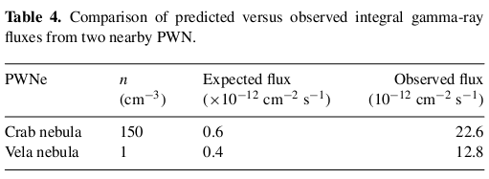

Slide 31
The neutrino fluxes from the nebulae would be of nearly the same to those of gamma-rays. Incorporating the neutrino oscillation effect, the expected event rates in a neutrino telescope due to
TeV muon neutrinos from nebulae of Crab and Vela are 0.2 and 0.1 km⁻²yr⁻¹ , respectively. Note that the event rates obtained here are rough numerical values. The flux will be higher if the accelerated ion is heavier than proton.

Slide 32
Conclusion
Pulsars/Magnetars are unlikely to be strong sources of TeV neutrinos.
The non-detection of any statistically significant excess from the direction of any pulsar by the Antarctic Muon and Neutrino Detector Array (AMANDA)-II tele-scope (Ahrens et al. 2004; Ackermann et al. 2005, 2008) is as per expectations.
If protons are accelerated to PeV energies by the pulsar, then pul-sar nebulae are more probable sites of energetic neutrinos
Even for pulsar nebulae the expected event rates are small and the detection probability of pulsar nebulae by IceCube seems low.
Ref: MNRAS, 395, 1371(2009)

Slide 33
~ Thank you ~

Slide 34
The energy spectrum of cosmic rays extends to extremely high energies, values exceeding 10²⁰ eV.
The exact source of the high-energy cosmic rays is still unknown.
Supernova remnants (SNR), Active Galactic Nuclei (AGN), GRBs, Pulsars are among the potential sources for cosmic rays.
Accelerated protons of high energies are likely to generate a large associated flux of photo-produced pions, which decay to yield neutrinos.
The existence of a general flux of very high energy cosmic-ray protons thus implies the existence of sources of high-energy neutrinos.

Slide 35
the recent success of ground-based very-high-energy γ -ray telescopes has opened a new window on the most powerful and violent objects of the Universe, giving a new insight into the physical processes at work in such sources.
Neutrinos are produced in high-energy hadronic processes. In particular they would allow a direct detection and unambiguous identification of the sites of acceleration of high-energy baryonic cosmic rays, which remain unknown.
high-energy neutrinos provide a unique probe to detect and identify high-energy hadronic processes.

