Slide 1
Monte Carlo simulation in Physics research
Subhasis Chattopadhyay
Variable Energy Cyclotron Centre
Kolkata-India

Slide 2
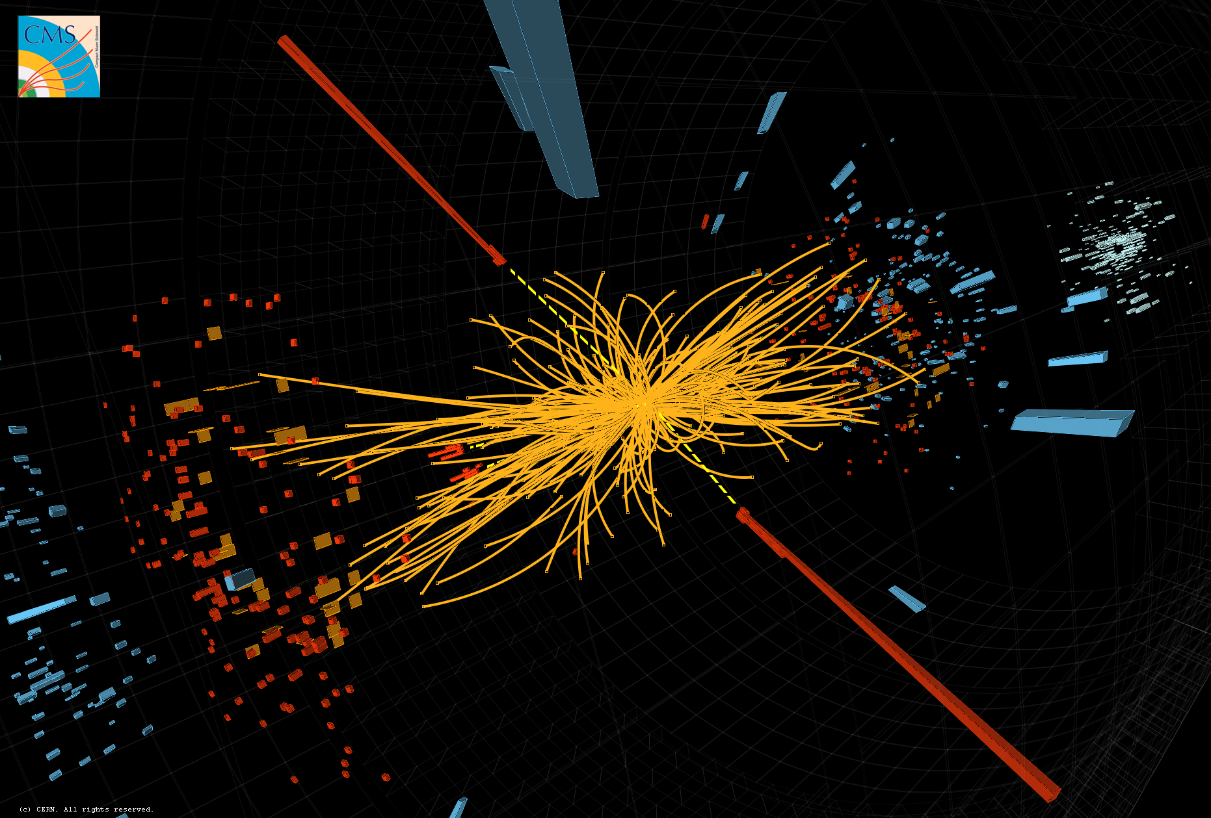
13/12/11: LHC reported Higgs going to gamma-gamma channel

Slide 3
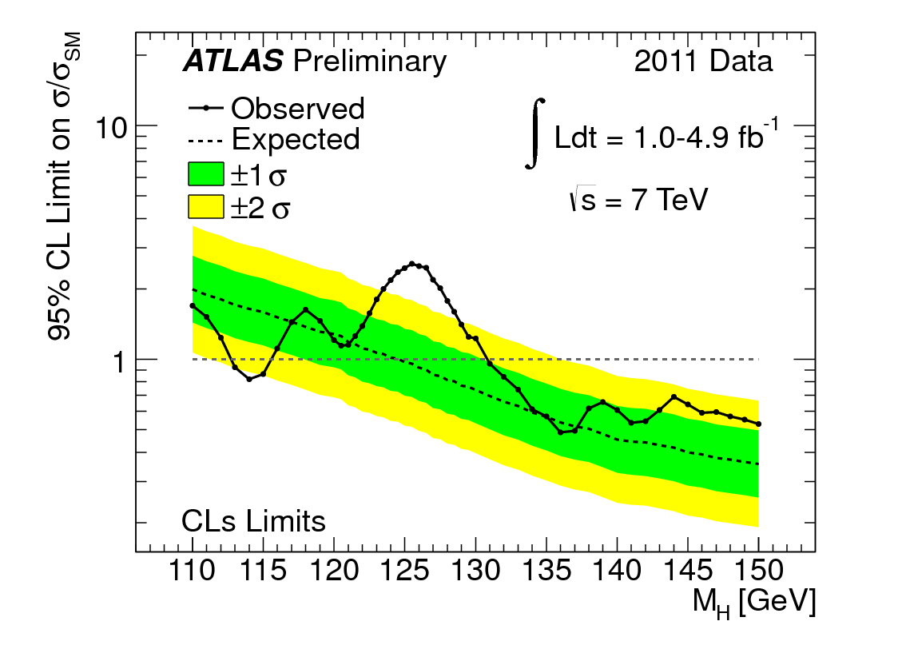

Slide 4
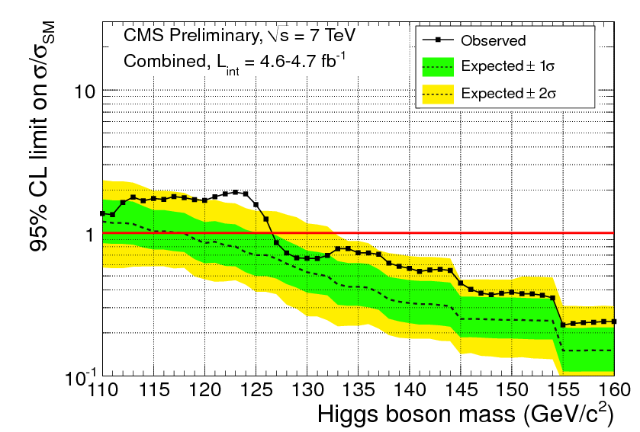

Slide 5
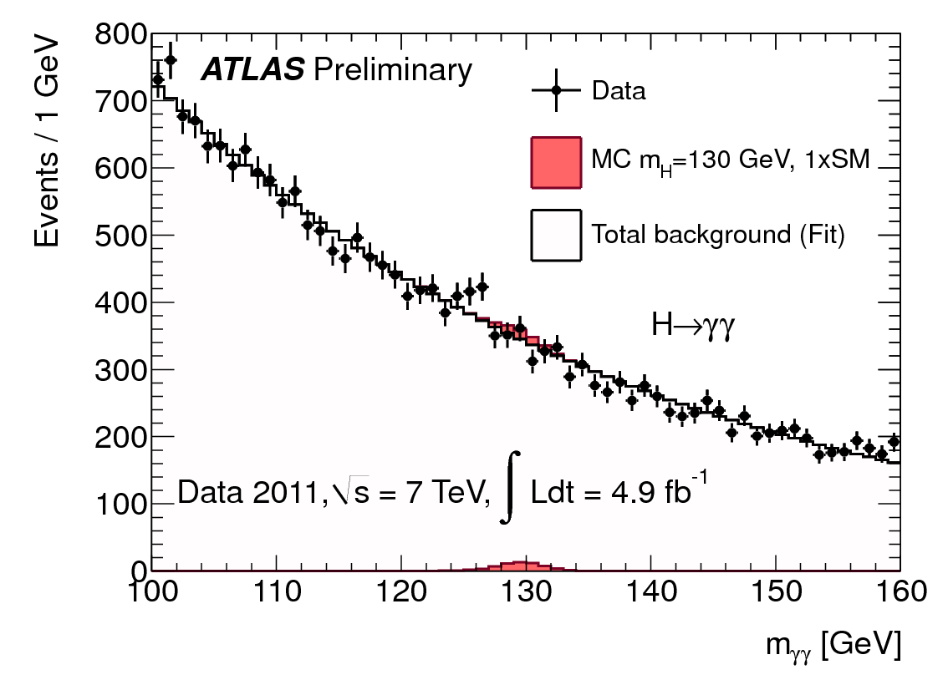

Slide 6
"We have restricted the most likely mass region for the Higgs boson to 115-130 GeV, and over the last few weeks we have started to see an intriguing excess of events in the mass range around 125 GeV," explained ATLAS experiment spokesperson Fabiola Gianotti. "This excess may be due to a fluctuation, but it could also be something more interesting. We cannot conclude anything at this stage. We need more study and more data. Given the outstanding performance of the LHC this year, we will not need to wait long for enough data and can look forward to resolving this puzzle in 2012."
A
T
L
A
S
Our preliminary results, for several statistical confidence levels [3], exclude the existence of the SM Higgs boson in a wide range of possible Higgs boson masses:
127 – 600 GeV at 95% confidence level,
128 – 525 GeV at 99% confidence level.
C
M
S

Slide 7
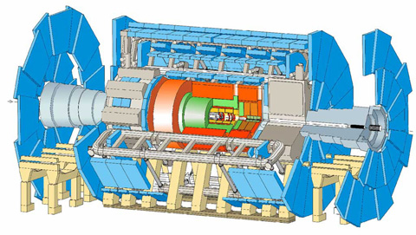
ATLAS detector
Size: 46 m long, 25 m high and 25 m wide.
The ATLAS detector is the largest volume particle detector ever constructed.
Weight: 7000 tonnes
Design: barrel plus end caps
Location: Meyrin, Switzerland.

Slide 8
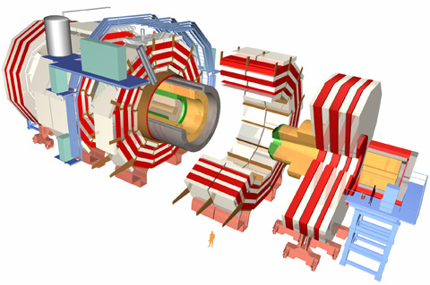
CMS detector
Size: 21 m long, 15 m wide and 15 m high.
Weight: 12 500 tonnes
Design: barrel plus end caps
Location: Cessy, France.

Slide 9
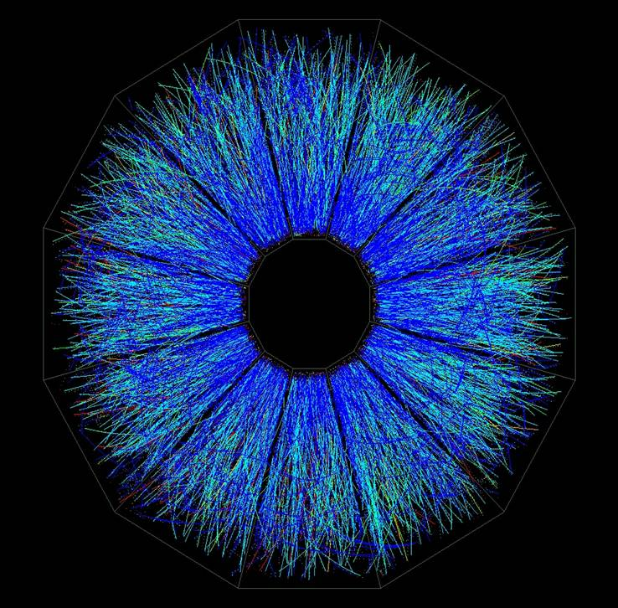

Slide 11
High Energy physics experiments: general philosophy
ν
Muon chambers
µ
Hadronic calorimeter
γ
e
Electromagnetic calorimeter
n
p
Inner detector

Slide 12
Billions of dollars spent
Two decades of preparation….
If the frame would have become dark…
If the detector-materials are not thick enough to stop the particles..
Design the detectors by Monte Carlo simulation
We have detected one Higgs-like signal by gamma-gamma channel
→ What if they are generated by the detector materials and no real…
OR they are just background from known physics
Perform Monte-Carlo simulation

Slide 13
Let us take two scenarios..
1. Deterministic (e.g. Number of students in this class)
Stochastic (e.g.
which nuclei will collide?
Which particles will be generated?
Which detector cell will register first signal?
What will be the momentum of the first photon created?
……..
Which number will come in GAMBLING???
What we know….
a. Average number of nuclei collided
b. Average momentum of the produced particles…
c. Average number of days you can see Kanchanjungha…
→ But then there will be RANDOM fluctuation about the average numbers.

Slide 14
Monte-Carlo process comes from Gambling , where randomness is inherent..
What is a random number?
What is a random number distribution?
Known random number distributions..
Binomial
Poisson
Gaussian
……
Lorentzian
Many more..
Uniform random number and random numbers following specific distributions..
In MC procedure probability distributions are randomised to create event by event
simulation AND
Can perform integration using random numbers .

Slide 15
First application of the Monte-Carlo procedure..
Find the area of a circle..
Make a square surrounding the circle, the area of the square known
Generate (x,y) uniformly distributed inside the square (throw rice)
Count number of hits inside the square and the circle
Area of the circle = (N_C/N_S)*Area_of_the_square
How many points should we generate, error??

Slide 16
Pseudo-Random number generators…
Uniform random number generator.
(r)_i+1 = (a x r_i)mod m
Example with a=5, m=37
2. Properties of a good random number generator..
3. Random number between a range (-1 to +1 from (0-1))..
x = 2r -1
4. Random number following a specific distribution (x) from uniform random number r,
Conservation of probability says..
Mod(P(r) dr) = Mod(P(x) dx))
R = Int[P(x)dx)]_ infinity to x
5. Generating a Poissonian random number generator
6. A gaussian random number generator
→ r = Sum(r_i (i = 1 to N) – N/2 (mean= 0, sigma = sqrt(N/12)

Slide 17
Let’s take a more complicated simulation…
Simulating the time response of a Gas detector for incident photon pairs for
PET imaging
I. 511 keV photons pass through an absorber:
Random process:
Process of interaction: pair production, Compton scattering
(depends on material and photon energy)
II. Electrons enter the gas, ionize and generate signal son readout pads.
Random processes:
Ionization
Multiplication
Induction
Electronics response

Slide 18
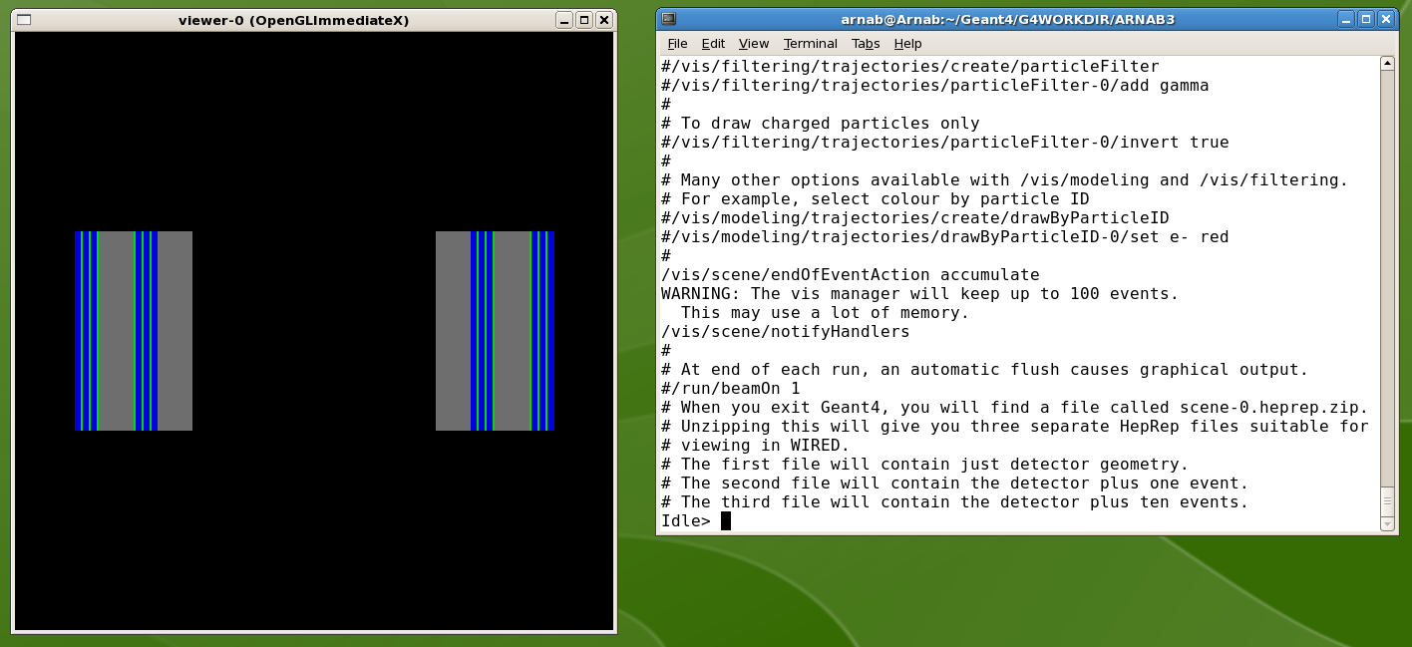
GEANT-4 for process I:
Toolkit for detector construction and simulation.
Detector material: glass (0.6 mm)
Gas gap : 0.2 mm
Gas mixture : ( Freon: Iso-butane: SF₆ ) 85:5:10
Converter material : Aluminium
Particle : Gamma ( 511keV )

Slide 19
Multi-gap RPC (an example of gas detector)
Single-gap:
9 mm width
primary ionization within
1.5 mm creates detectable
avalanches *
Generates a larger time jitter
+V
Primary
Ionization
9 mm
-V
+v
Primary
Ionization
Three-gap:
3mm width each (total 9mm)
primary ionization within
0.5 mm creates detectable
avalanches
Generates a less time jitter,
better time resolution
σ ~ (1/√n)
3 mm
Primary
Ionization
3 mm
Primary
Ionization
3 mm
-V
* The Multigap Resistive Plate Chamber, E. C. Zeballos, et.al., Nucl. Instr. And Meth. A 374 (1996) 132

Slide 20
MC simulation for MRPC response:
Total gap (d mm) is divided into n number of sub-gaps. So,
Δx = d/n (mm) ………(1)
corresponding to the time
Δt = Δx/v (μsec)………(2) , v = drift velocity (μm/ns)
In each step primary ionization and the avalanche process is simulated.
Avalanche development probability is governed by
α and η being the Townsend and the Attachment coefficient.
For each incident particle current and induced charge is simulated from the
following formulae:
i(t) = (E_{w}/V_{w}) v e₀ N(t)…….(3),
q(t) = i(t) . Δt………(4)
Timing response of the detector is also simulated by introducing a charge
threshold (20 fC in our case).
In this simulation space charge effect is also considered.
Ref: Werner Riegler et al. , NIM A 500 (2003) 144.

Slide 21
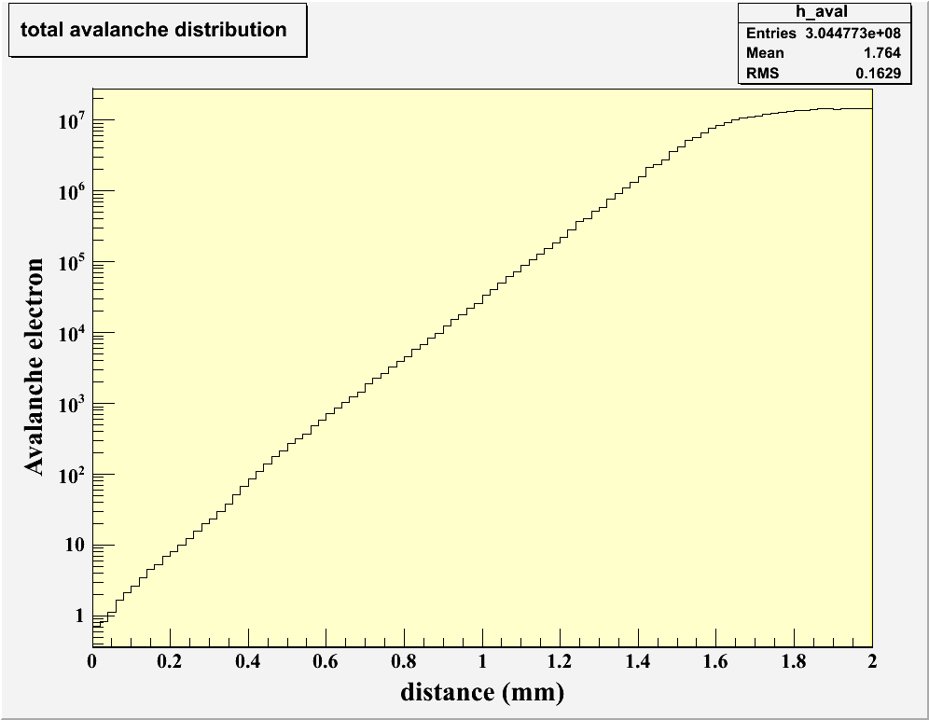
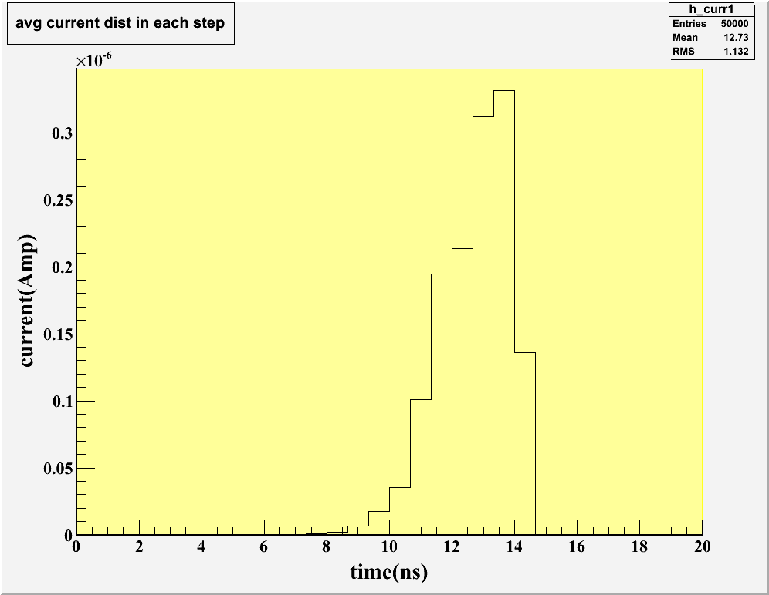
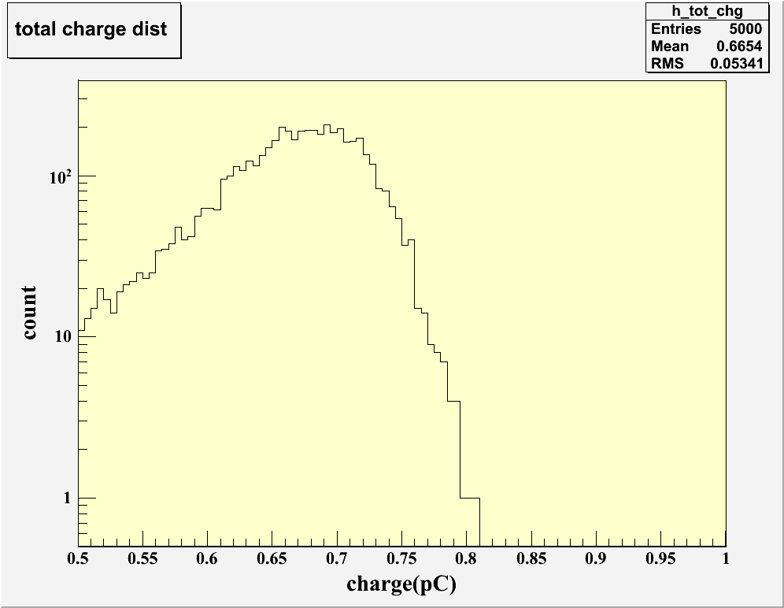
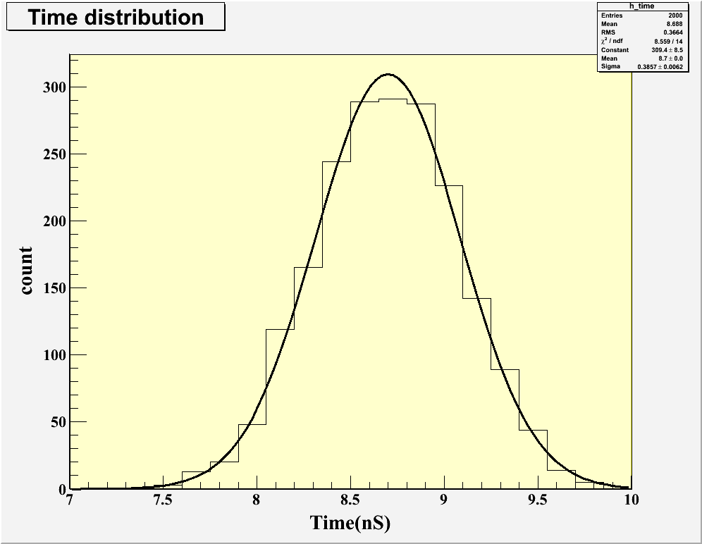
Simulation Result for conventional single gap RPC
Freon : iso-butane:SF6 = 85:5:10
E = 50kV/cm, α = 13.3/mm, η = 3.5/mm, v = 140 μm/ns, d = 2mm, b = 2mm
Avalanche distribution
Avg. current vs. time
Charge vs. time
Time spectrum

Slide 22
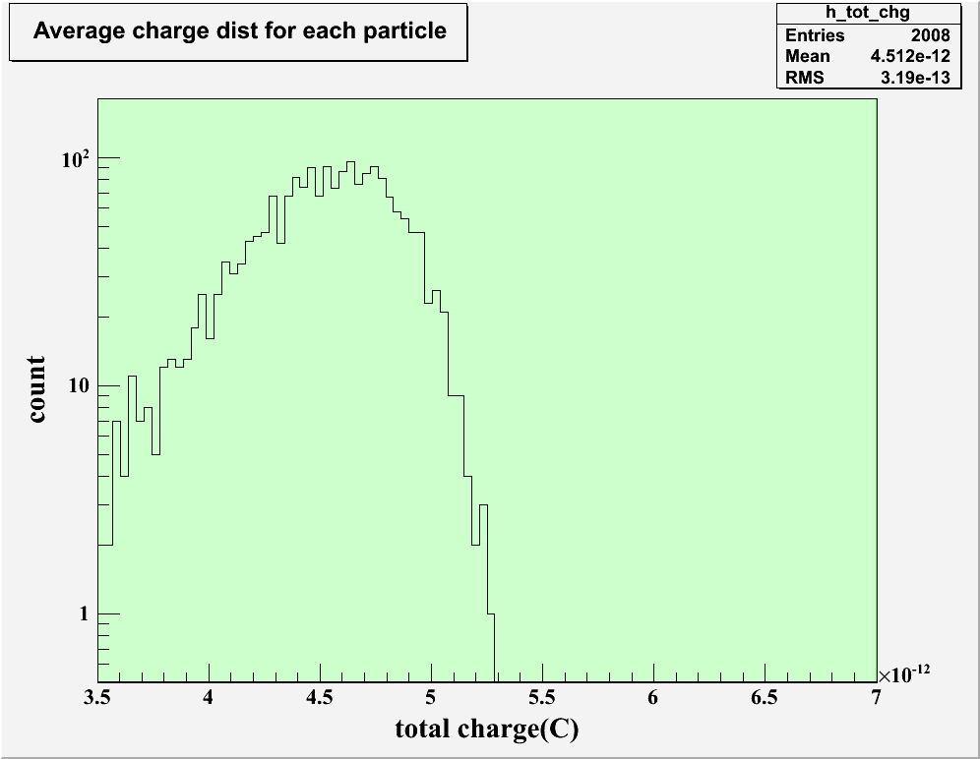
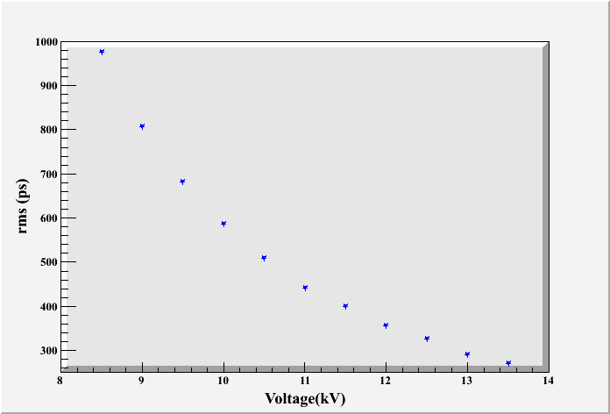
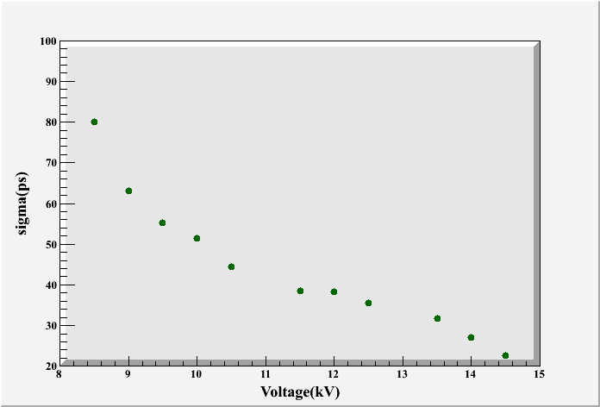
Charge spectrum
rms vs. voltage
Sigma vs. voltage

Slide 23
MC simulation in physics:
Two steps:
Physics process simulation (Even generator)
PYTHIA, HIJING…
Transport of particles through the detector:
Available toolkits for High Energy physics detectors imulation
GEANT3
GEANT4
….

