Slide 1
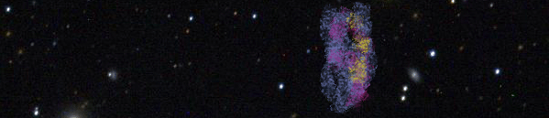
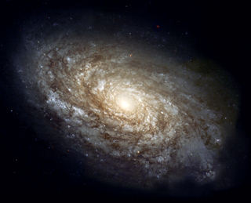
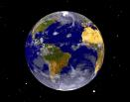
Gamma-ray Astronomy in India
(Multi-messenger approach for cosmic ray astrophysics)
γ
ν
p
  B.S.Acharya
  Tata Institute of Fundamental Research,
  (acharya@tifr.res.in)
6th Winter School on Astro-Particle Physics
Bose Institute, Darjeeling, December 20-29, 2011

Slide 2
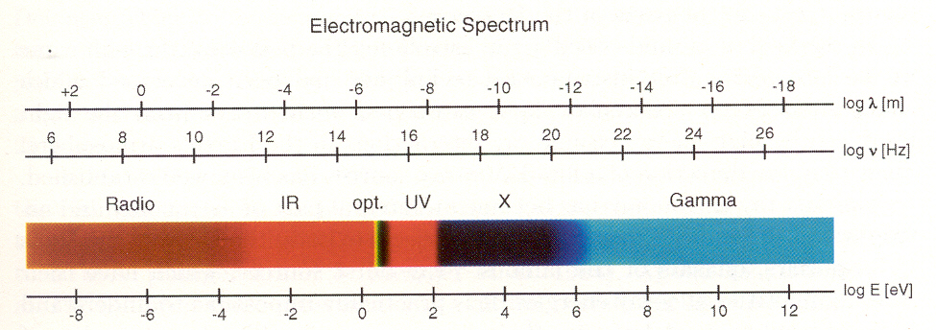
Matter in the form of Cosmic rays, Neutrino, Dark matter etc.
Radiation in the form of Electro-Magnetic radiation, gravity waves etc.

Slide 3
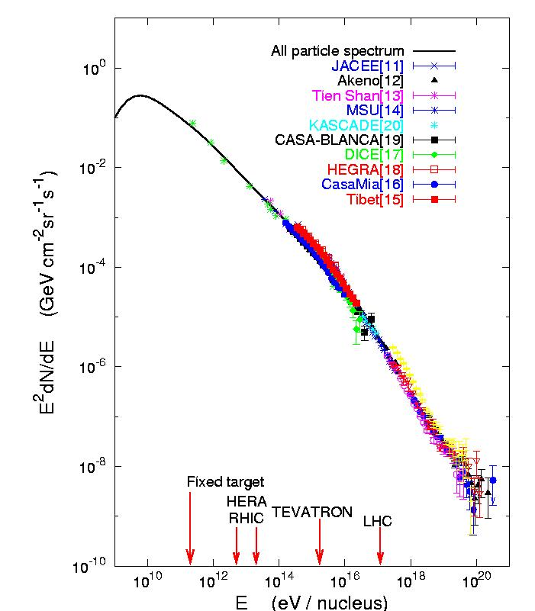
10²⁰ eV
~ equivalent to KE
of a cricket ball moving
at 150 kmph
Knee
Ankle
air-showers
>10¹⁹ eV
1 km⁻² sr⁻¹ year⁻¹
>10²⁰ eV
1 per km² per Century
after Gaisser

Slide 4
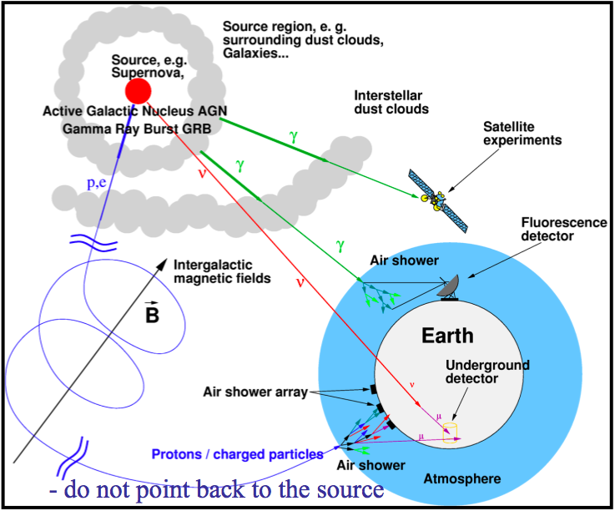
Multi-messenger astronomy
At the earth, most of the cosmic rays are protons: deflected by intergalactic magnetic fields (do not point back to source) .
Gamma rays (photons): easier to detect; propagate in a straight line but may be absorbed en route.
Neutrinos: propagate in a straight line, not absorbed but difficult to detect, need large detectors.
γ
ν
p

Slide 5
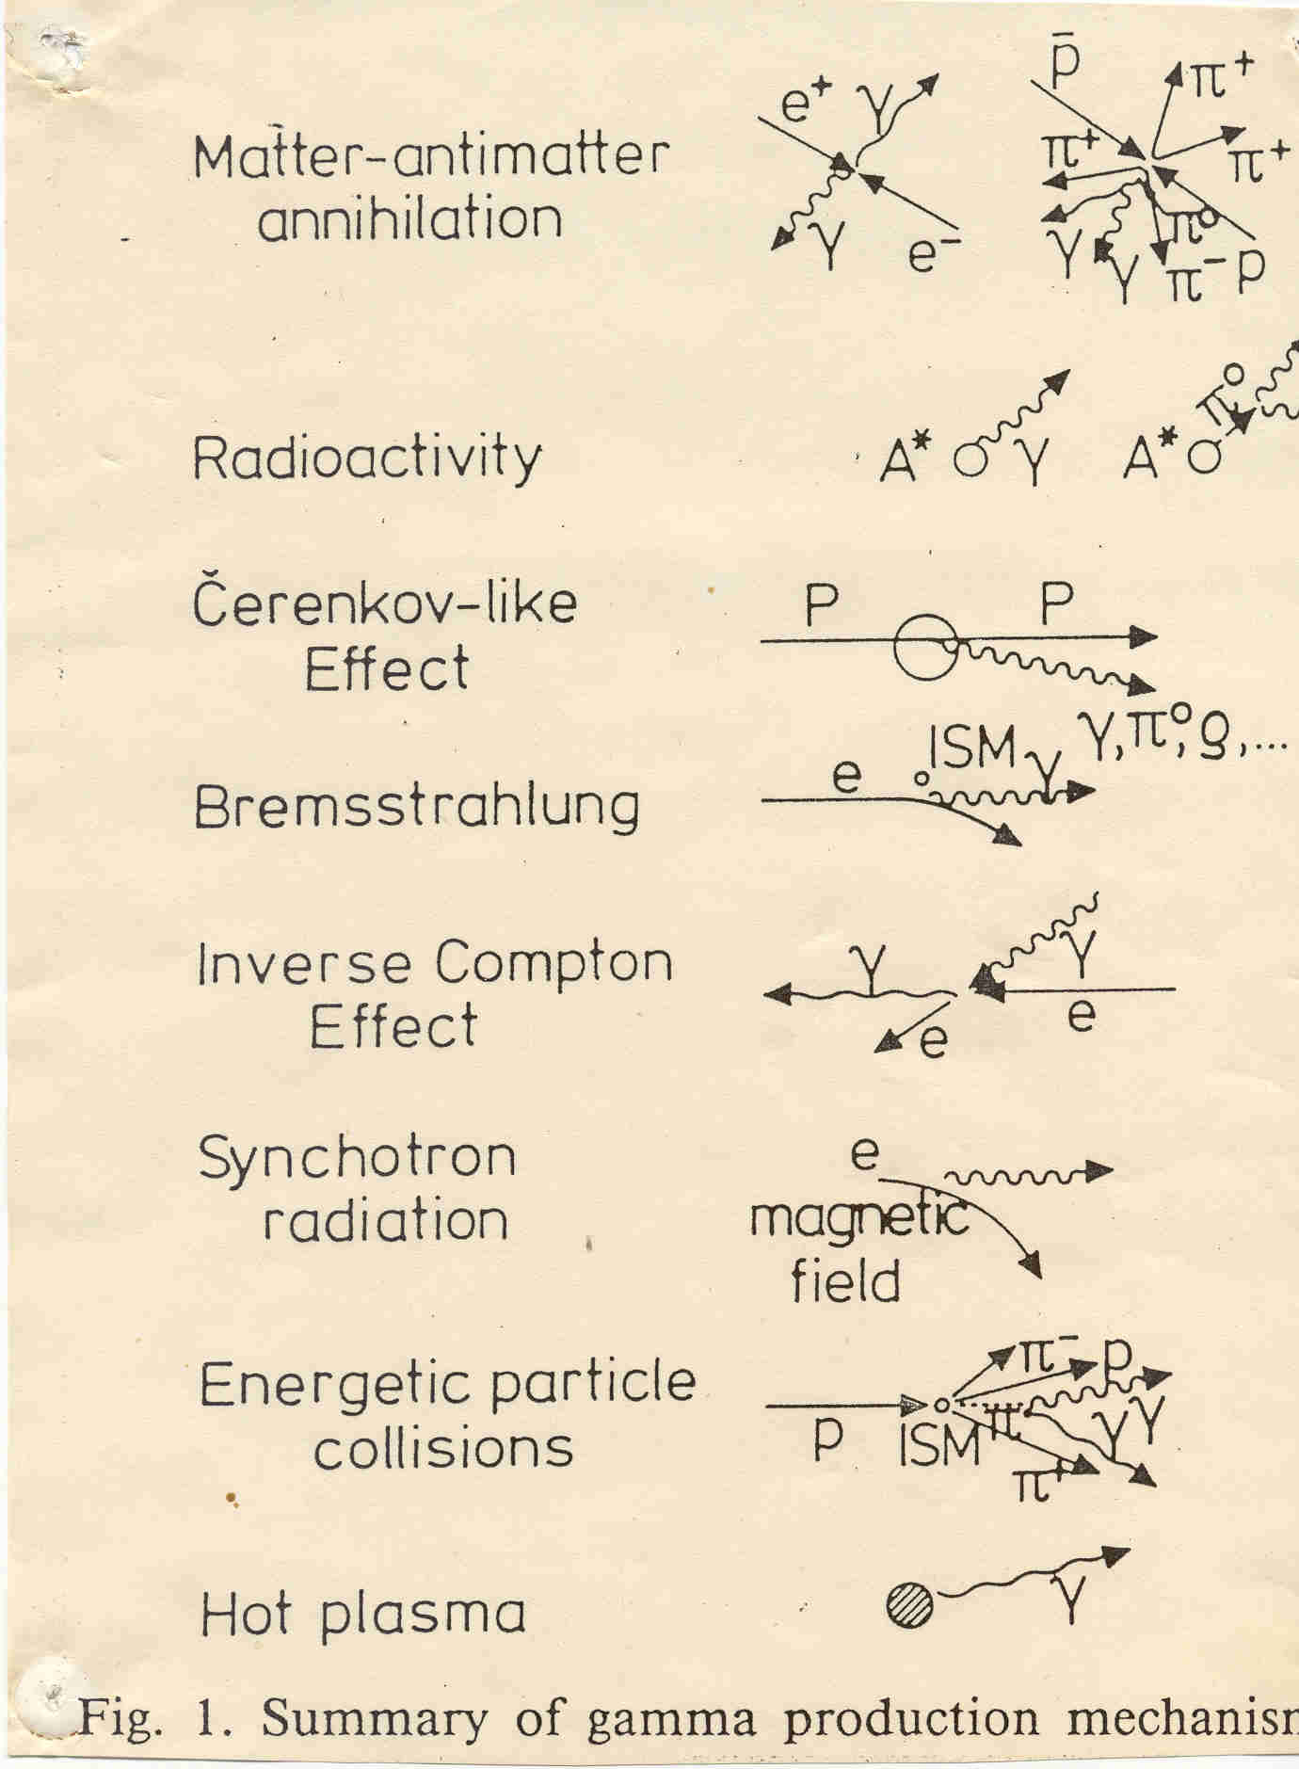
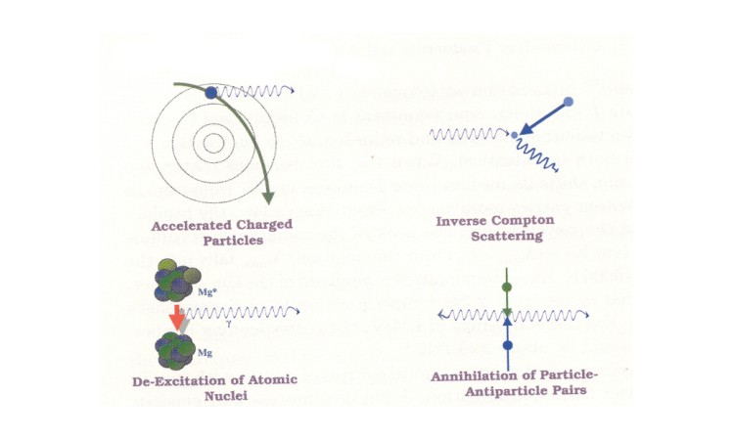
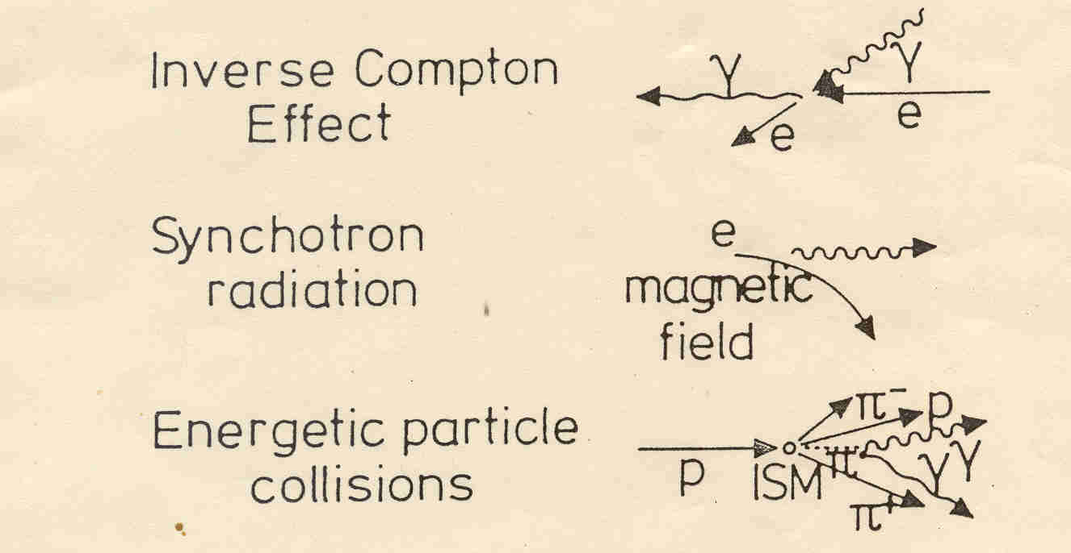
Gamma-ray Production
High Energy Gamma-rays are due to the presence of
Energetic electrons/protons, High Magnetic fields.
These are potential sites for acceleration of Cosmic-rays.
+ GRB, Decay of dark matter, etc.

Slide 6
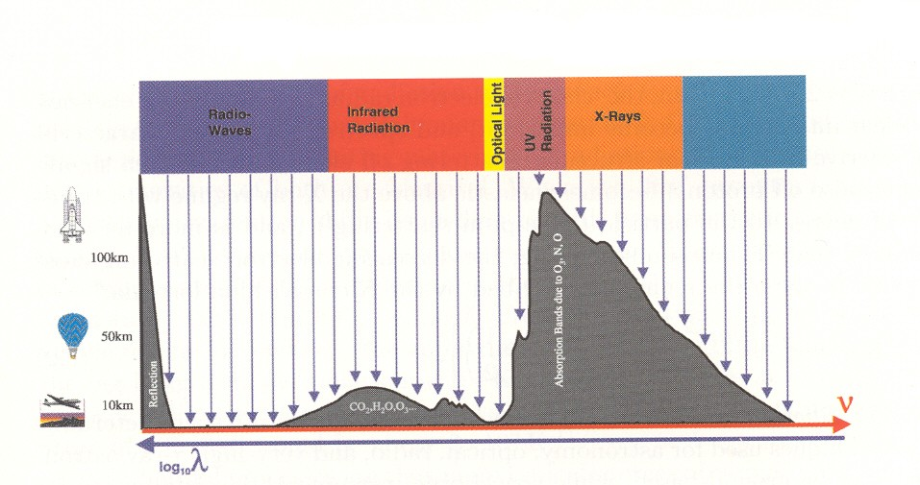
Transparency of Atmosphere to EM radiation
Observations
Satellite-based
Balloon-based
Air-plane altitudes
Mountain altitudes
Ground-based
Gamma-ray astronomy deals with highest energy photons from space.
It gives a perspective of non-thermal universe which compliments our view from other spectral windows.
Gamma radiation is generated under extreme conditions in objects or phenomena like black holes and violent explosions (supernova, hyper- nova, gamma-ray bursts etc) seen across the universe.
The objective is to study these powerful objects and violent events in order to understand Nature at its ultimate limits, which perhaps help to explore the limits of gravity and energy in the universe and to forecast our cosmic destiny.

Slide 7
The Bhabha-Heitler Model
E₀
W. Heitler, The Quantum Theory of Radiation ,3rd Ed., (1954), p.386.

Slide 8
“Heitler’s Model”
E₀
E₀/2
W. Heitler, The Quantum Theory of Radiation ,3rd Ed., (1954), p.386.

Slide 9
Heitler Model
E₀/4
W. Heitler, The Quantum Theory of Radiation ,3rd Ed., (1954), p.386.

Slide 10
Heitler Model
Energy is evenly split between two secondaries.
Cascade stops after “n_{c}” splits when individual energies are too low: critical energy ξ_{c}.
(ξ_{c} is when collision losses > radiative losses, 85 MeV in air)
λ_{r} = 37 g cm⁻² in air
(radiation length)
After “n” splits, there are “N” particles (e⁺, e⁻, and photons):

Slide 11
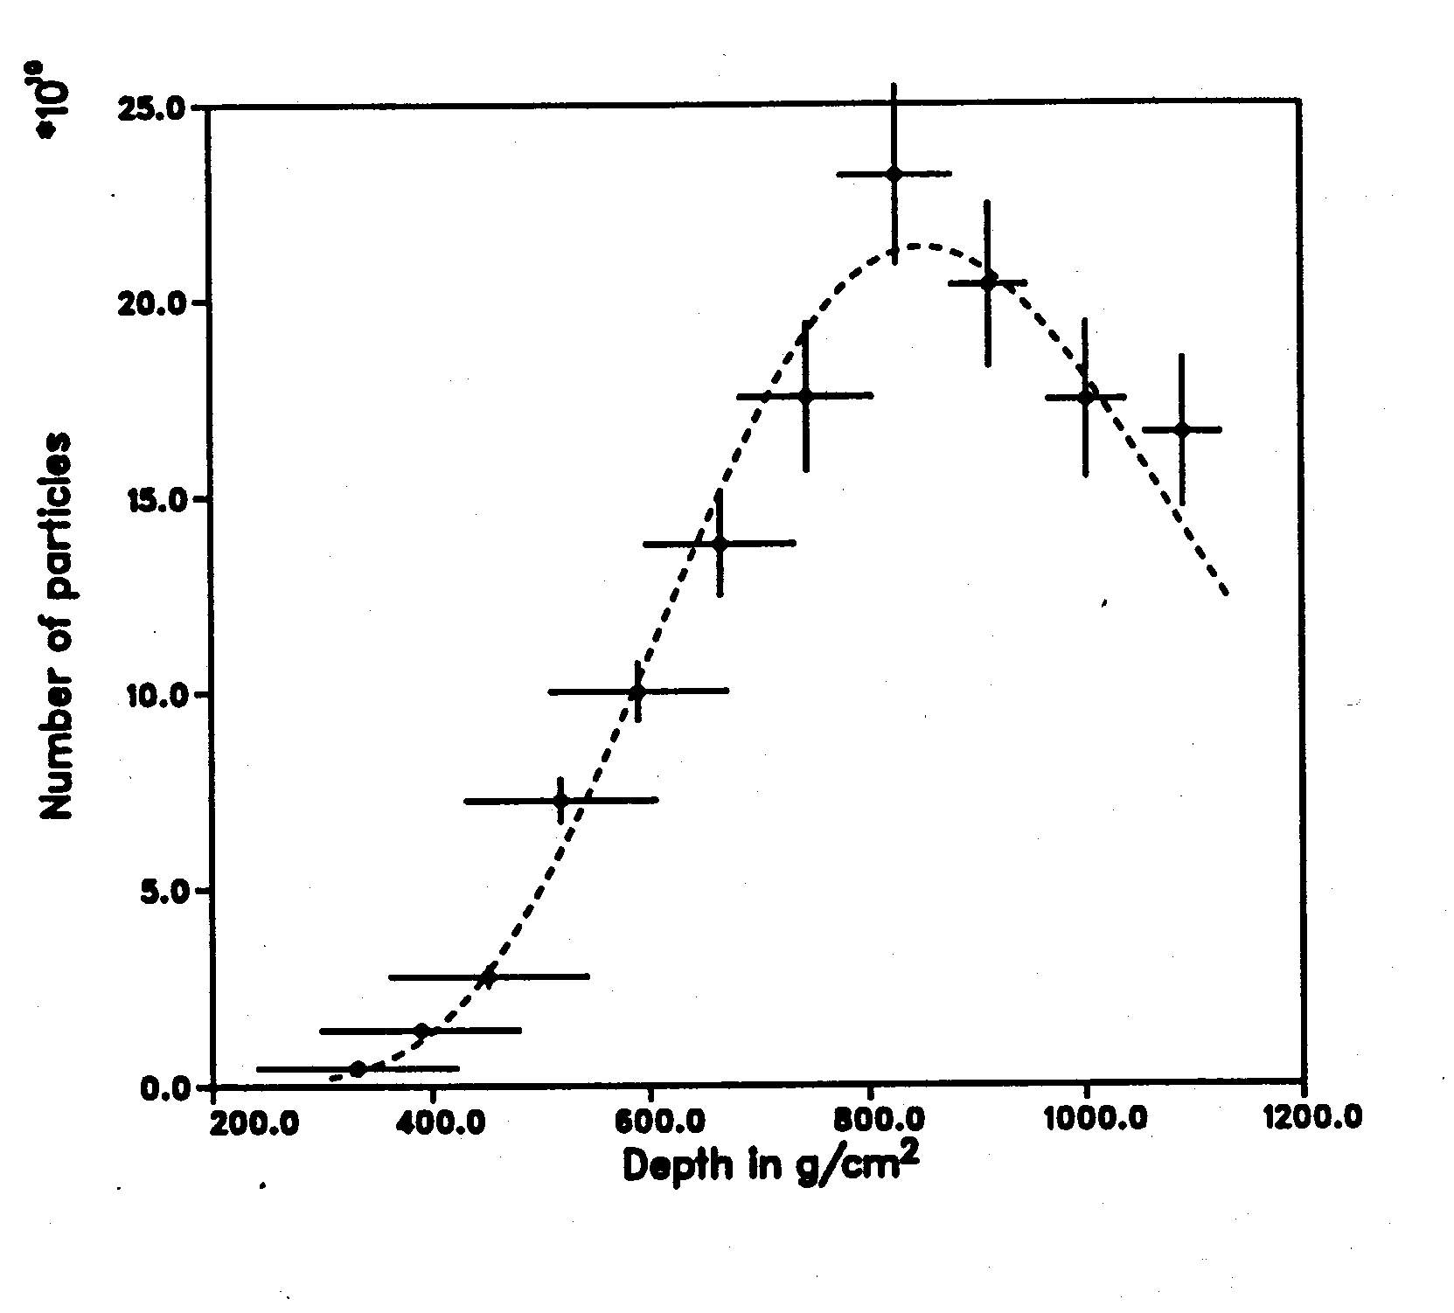
x 10¹⁰
3 x 10²⁰ eV !!!

Slide 12
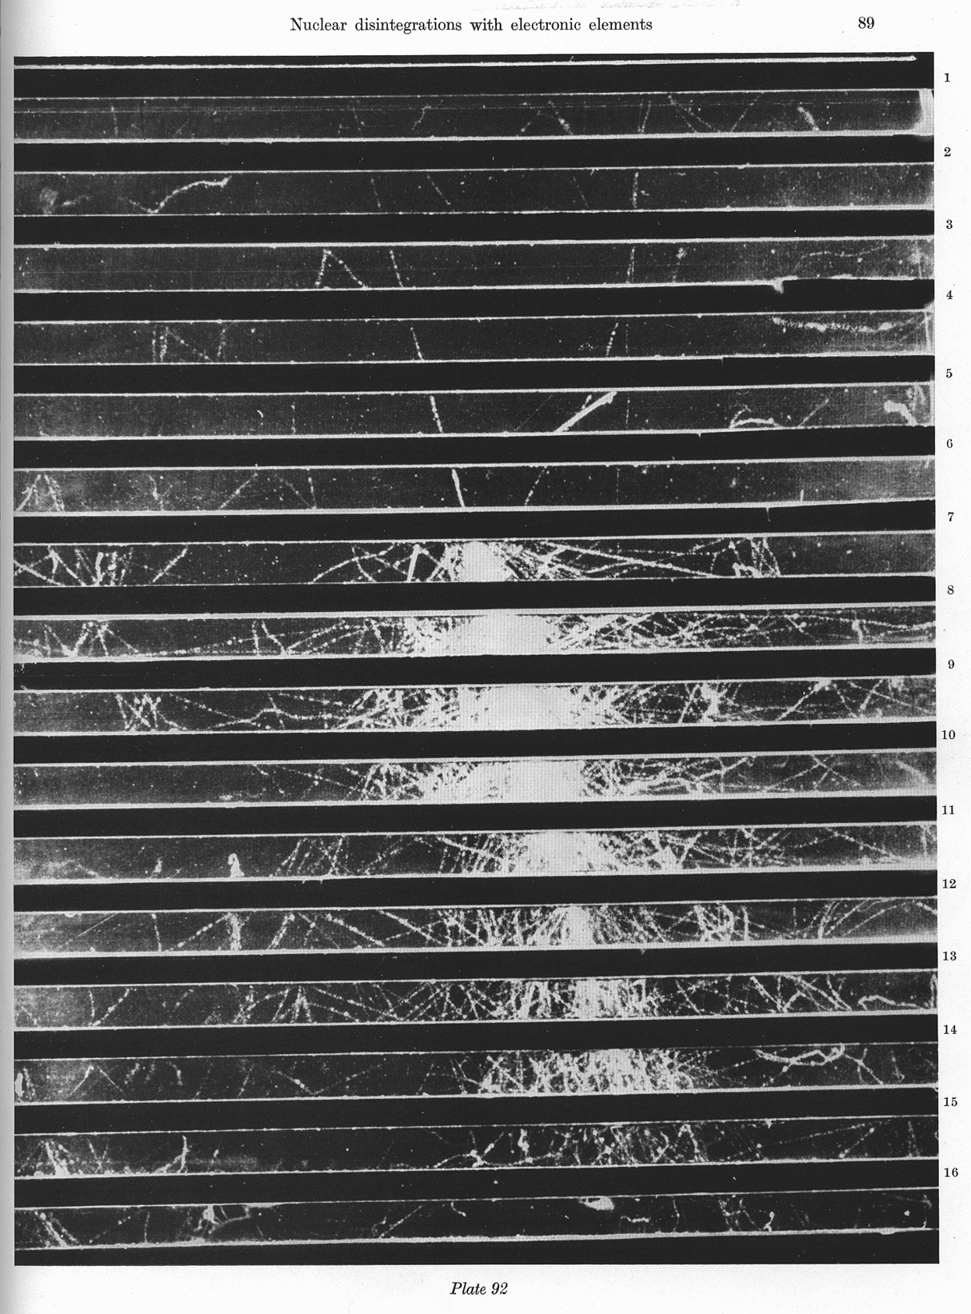
1.3 cm Pb
Shower initiated by
particle in lead plates
of cloud chamber
What is the particle?
What is the energy?
Fretter: Echo Lake, 1949

Slide 14
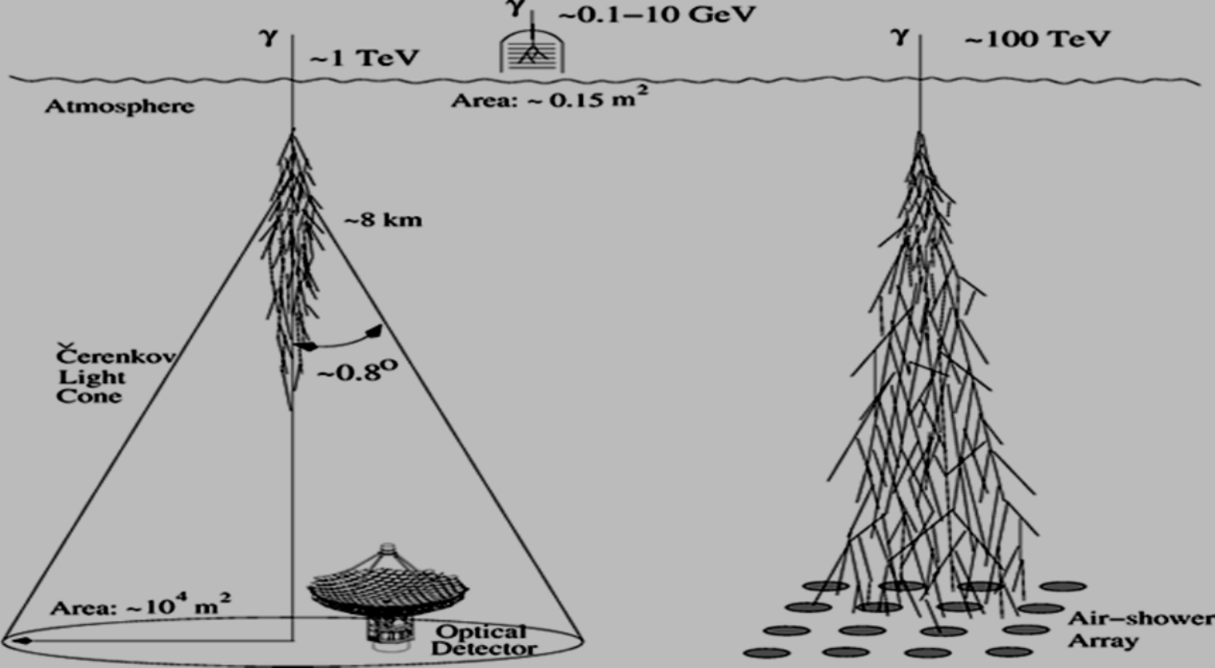
Gamma Ray Astronomy at different energy intervals
Narrow angle FOV; tracking telescopes
Wide angle FOV; stationary detectors

Slide 15
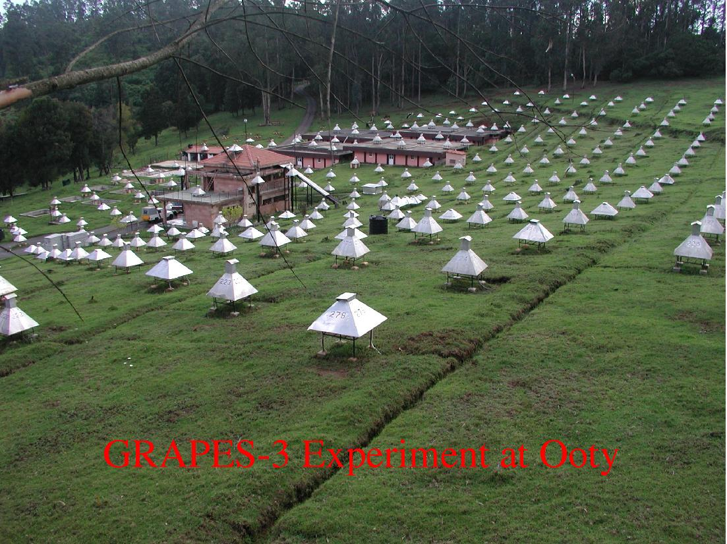

Slide 16
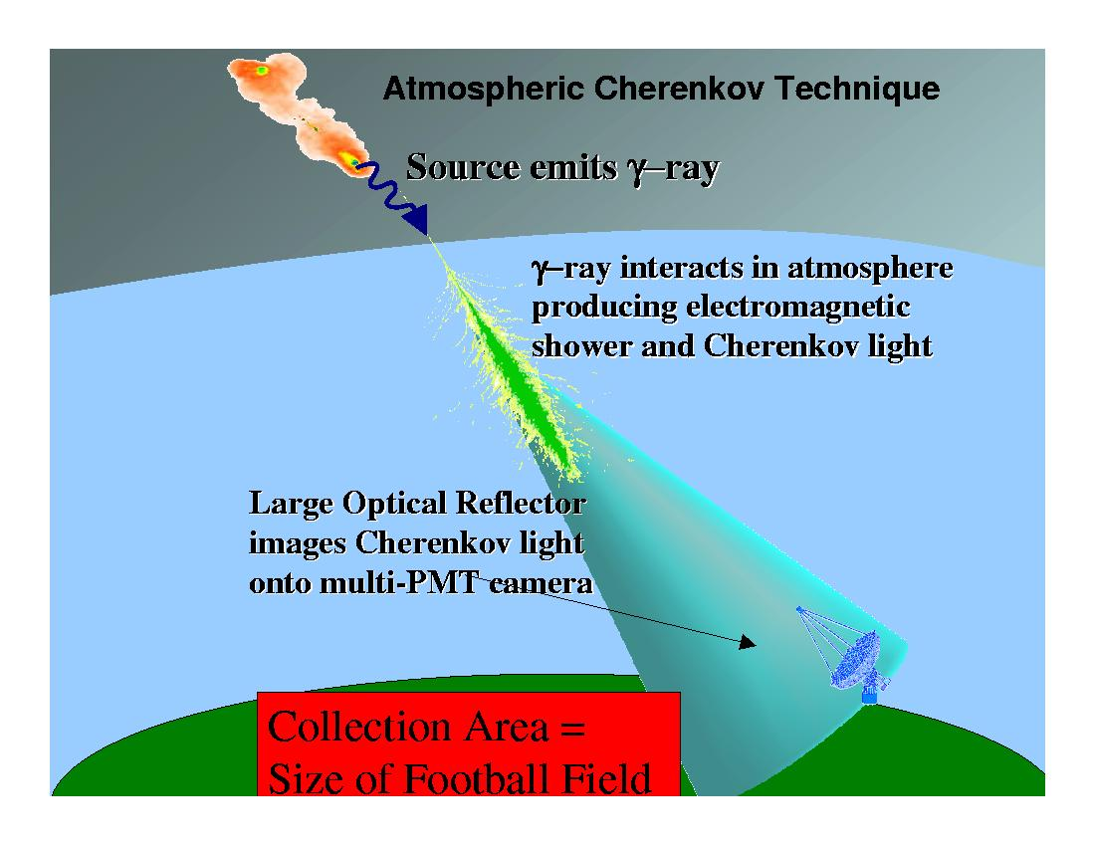
Cosmic rays are major
source of background

Slide 17
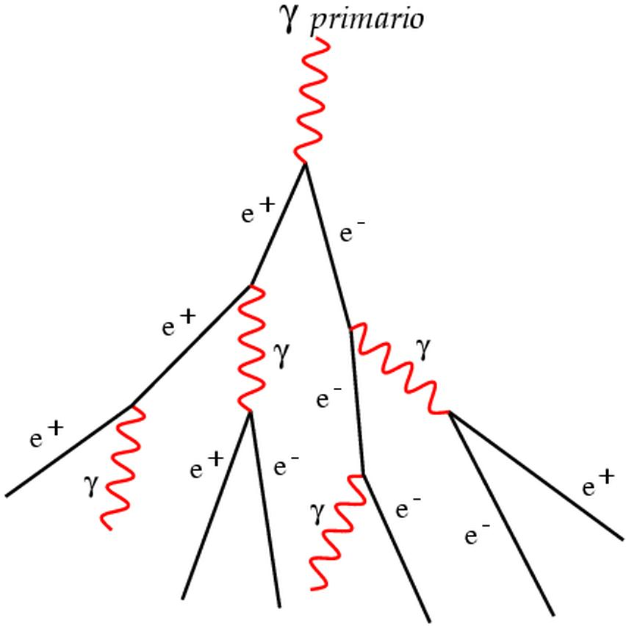
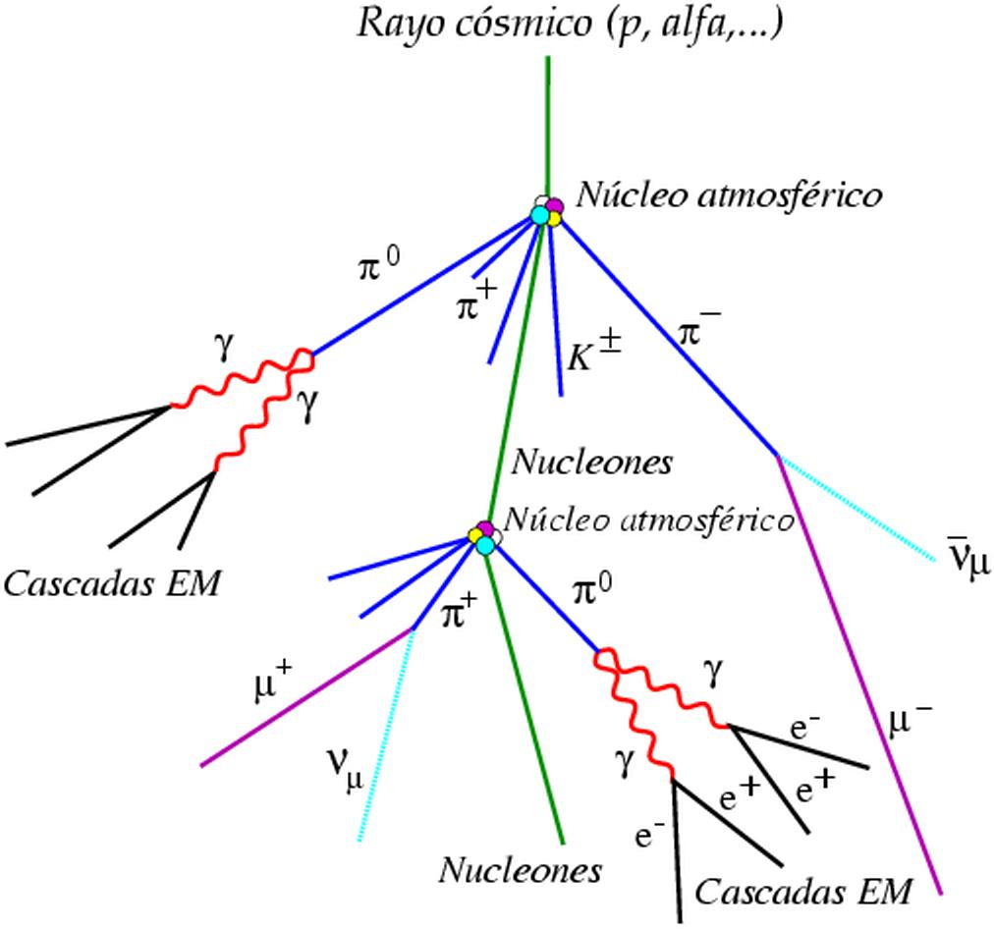
Extensive Air Showers (EAS)
Electromagnetic
Hadronic
Signal
Background

Slide 18
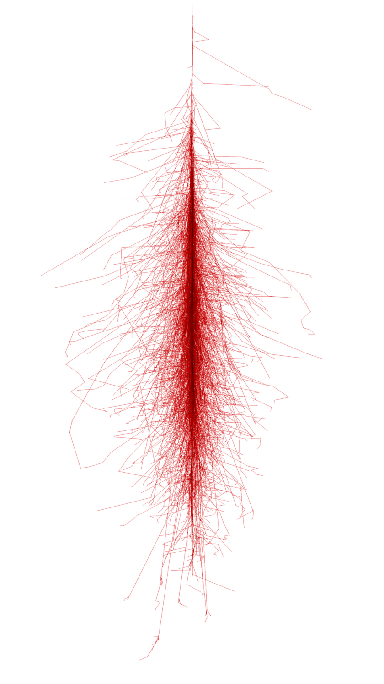
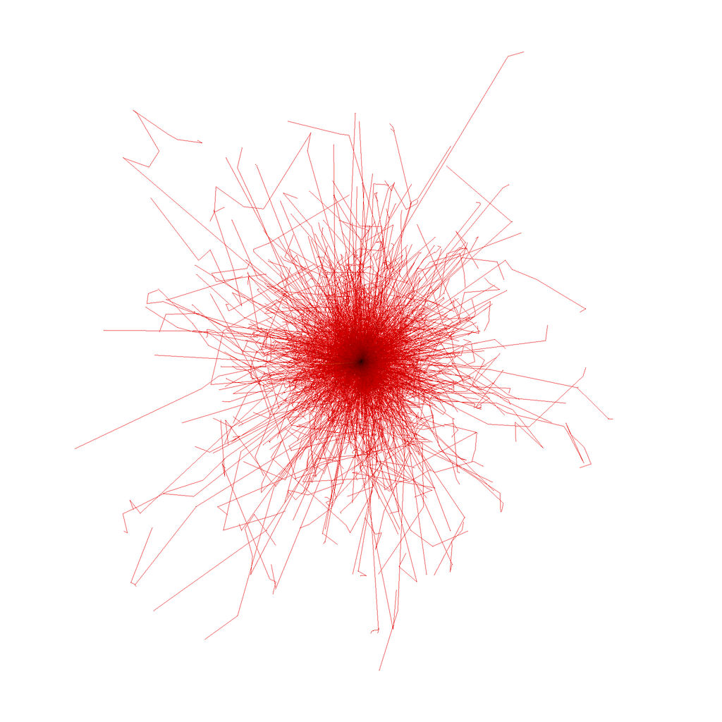
Simulated gamma
50 GeV
Fabian Schmidt, Leeds university
http://www.ast.leeds.ac.uk/~fs/showerimages.html

Slide 19
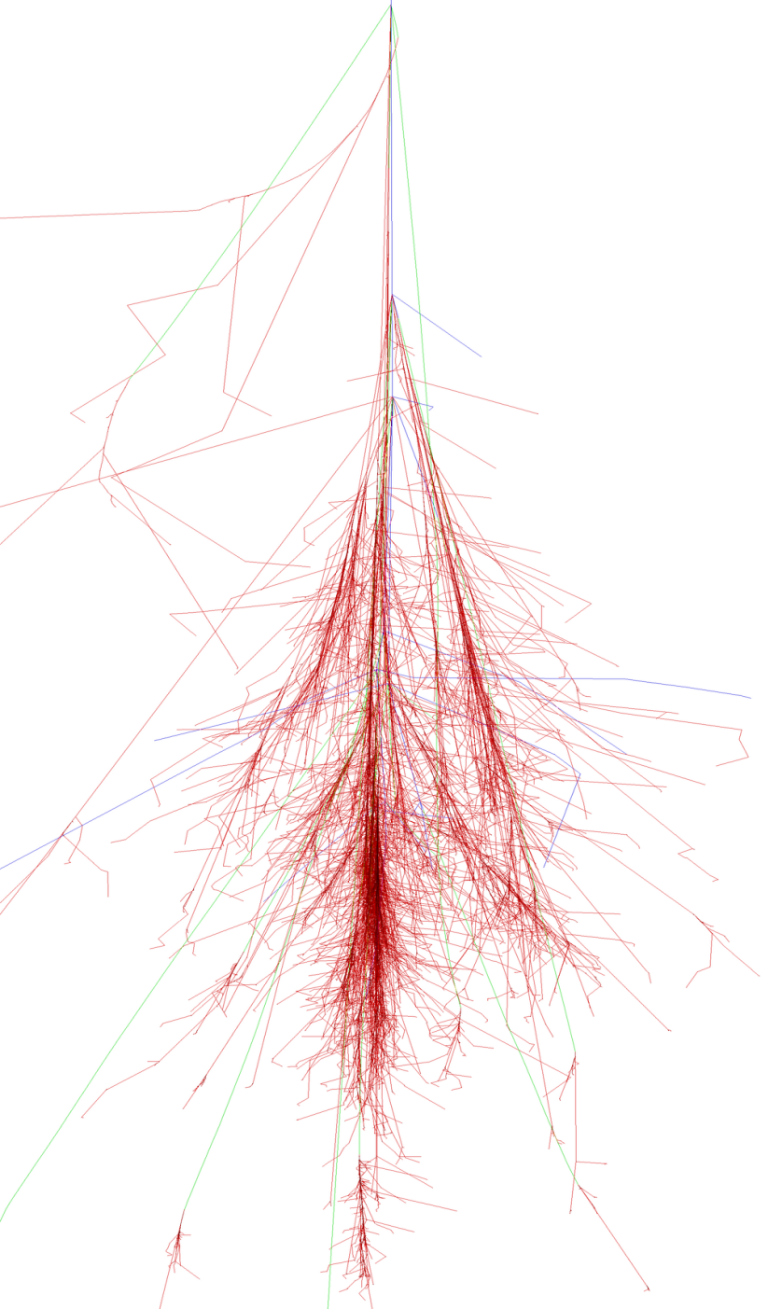
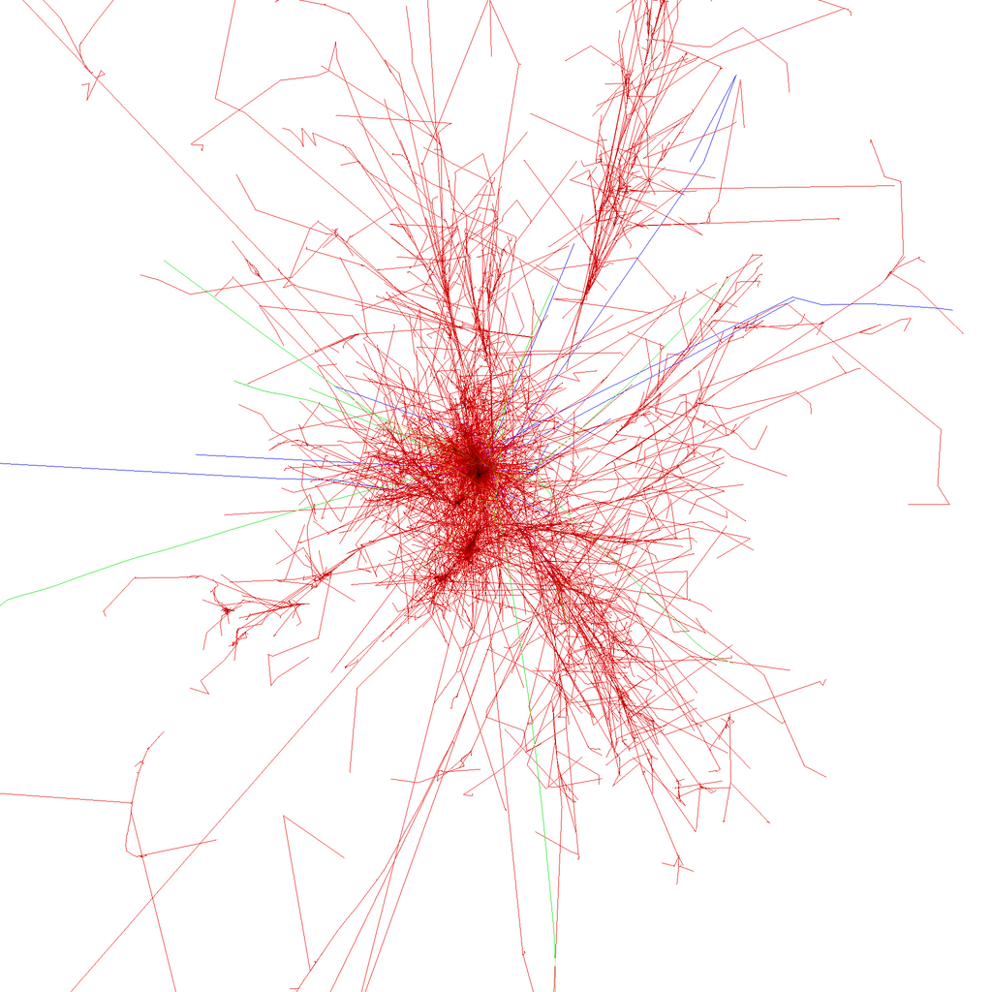
Simulated proton
100 GeV
muons
Fabian Schmidt, Leeds university
http://www.ast.leeds.ac.uk/~fs/showerimages.html

Slide 20
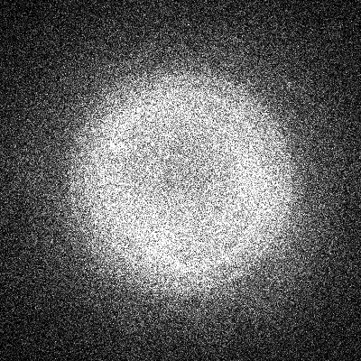
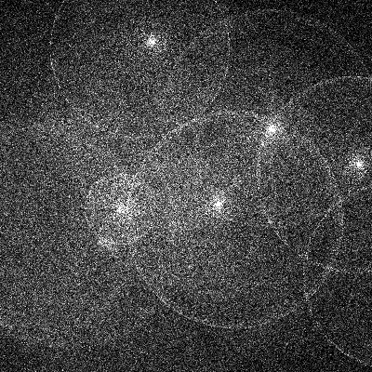
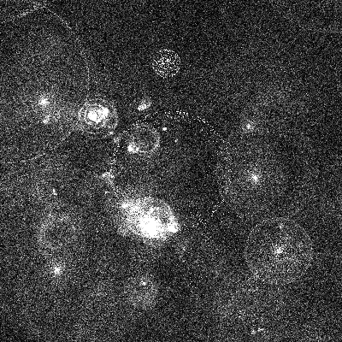
Spatial distribution of Cherenkov photons on ground
300 GeV γ-ray
1 TeV proton
5 TeV iron nucleus

Slide 21
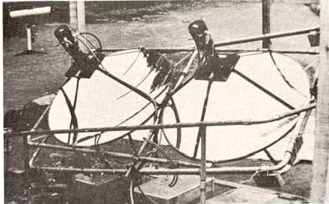
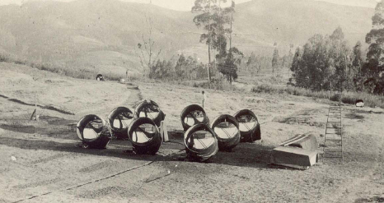
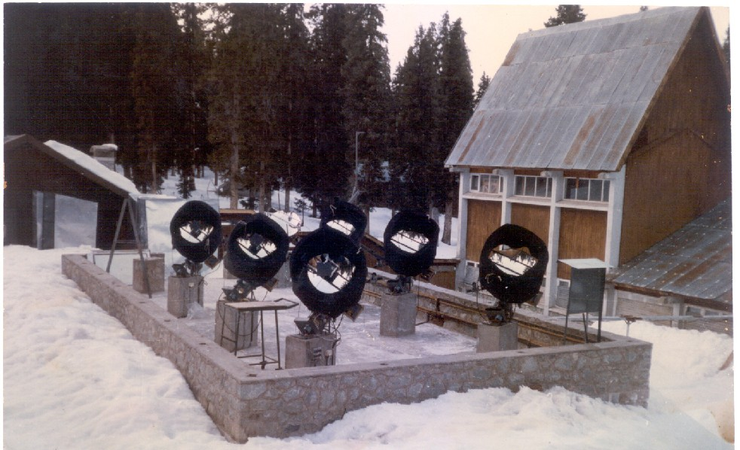
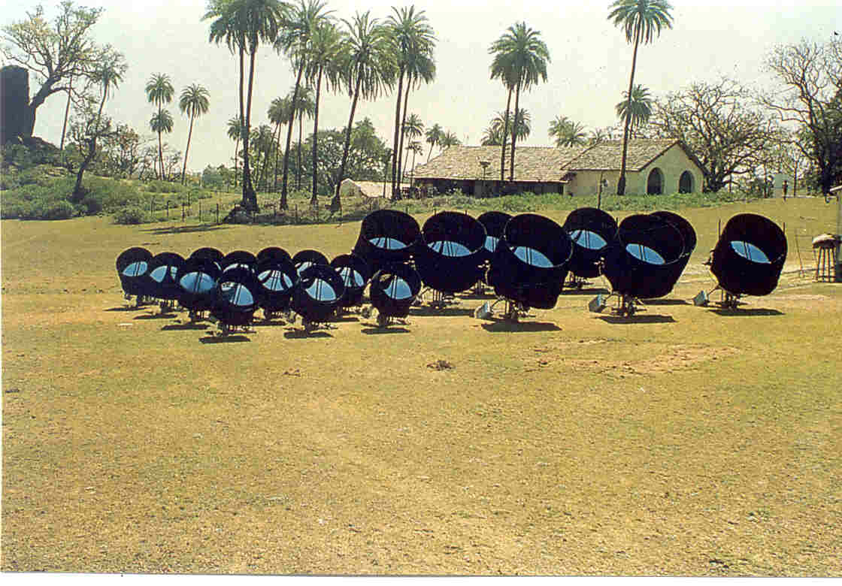
<- Ooty ( 1975-85)
Early History
Ooty ( 1969-70)
Gulmarg (1984-90)
<- Pachmarhi: 1986-2000

Slide 22
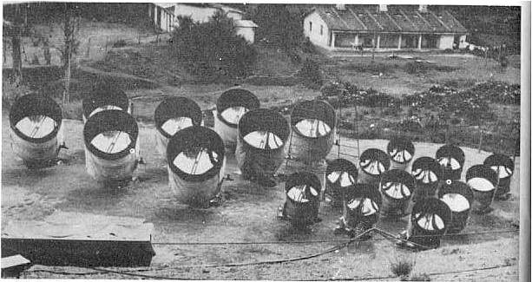
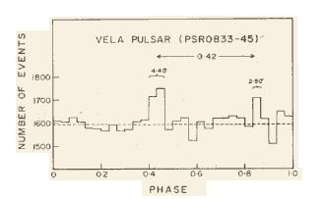
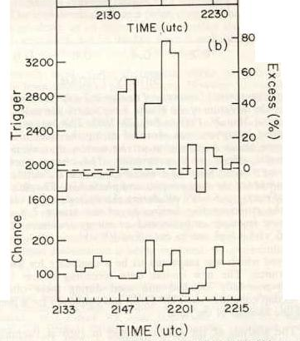
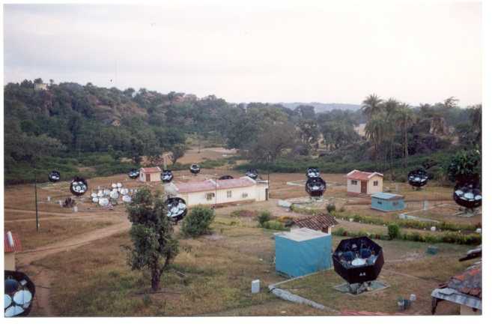
Ground-based Gamma-ray Astronomy (by TIFR group)
1969-70 Ooty
Radio Pulsars
(BK Chatterjee et al., Nature 225(1970)839; ibid 231(1971)126)
1975-85 Ootacamund
Crab, Vela and Geminga pulsars
(Gupta S.K., PhD thesis 1983)
1986-2K Pachmarhi
X-ray binaries: HerX-1, Cygnus X-3, 4U0115+63
(V.N.Gandhi, Ph.D. Thesis 1992)
2001- * PACT, Pachmarhi
Pulsars, AGN’s, GRB’s (P.Mjumdar, Ph.D. Thesis 2003) (DBose PhD 2007, BBSingh submittted 2008)
2004-*: Hanle (Ladak)
TIFR-IIA-BARC collaboration

Slide 23
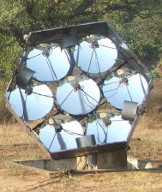

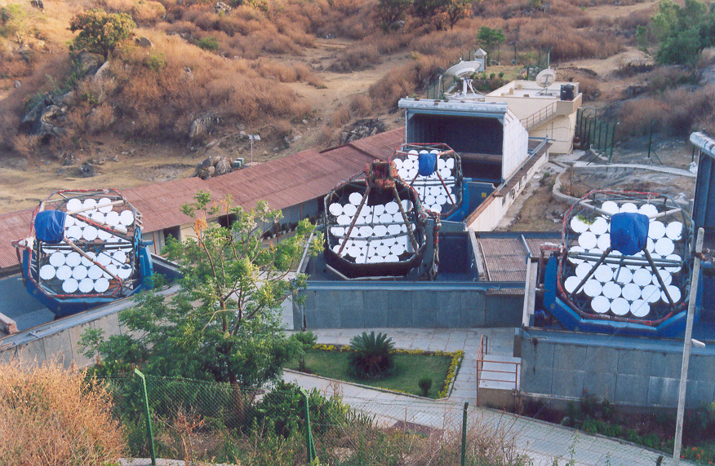
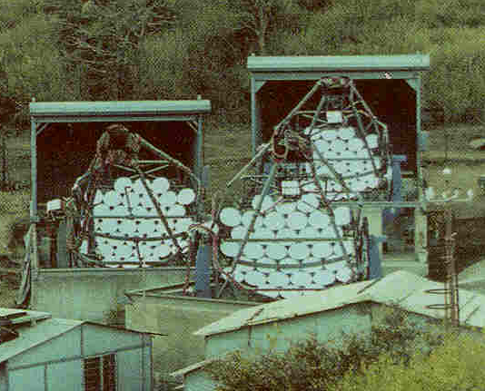
ACT Telescopes in India c.2001
Four element Imaging Telescope
TACTIC at Mt Abu 1992 –
Energy Threshold ~1 TeV
BARC
25 distributed telescopes
PACT at Pachmari 2001-
Energy Threshold ~850 GeV
TIFR

Slide 24
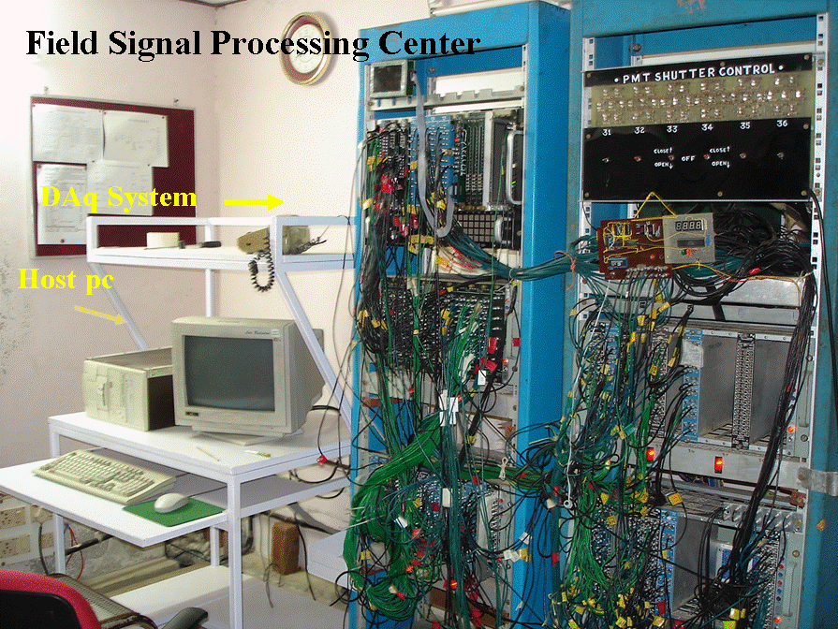
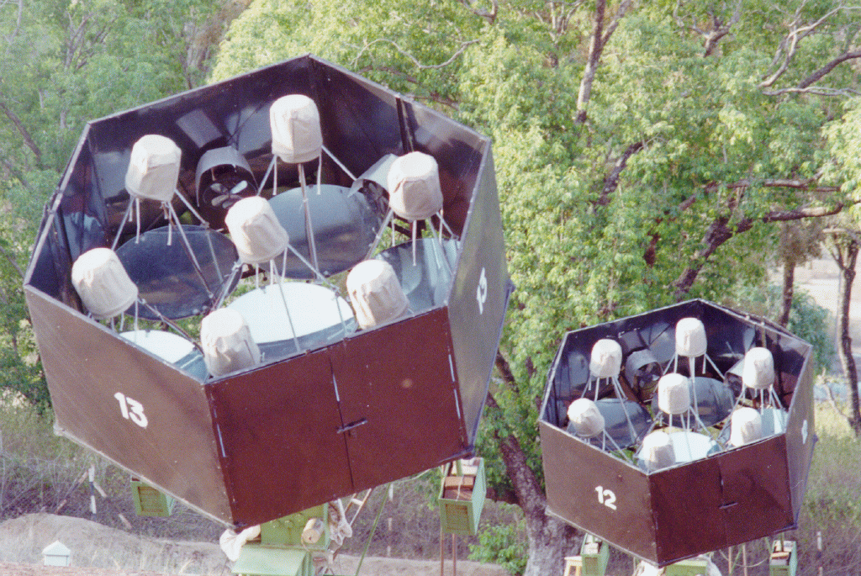
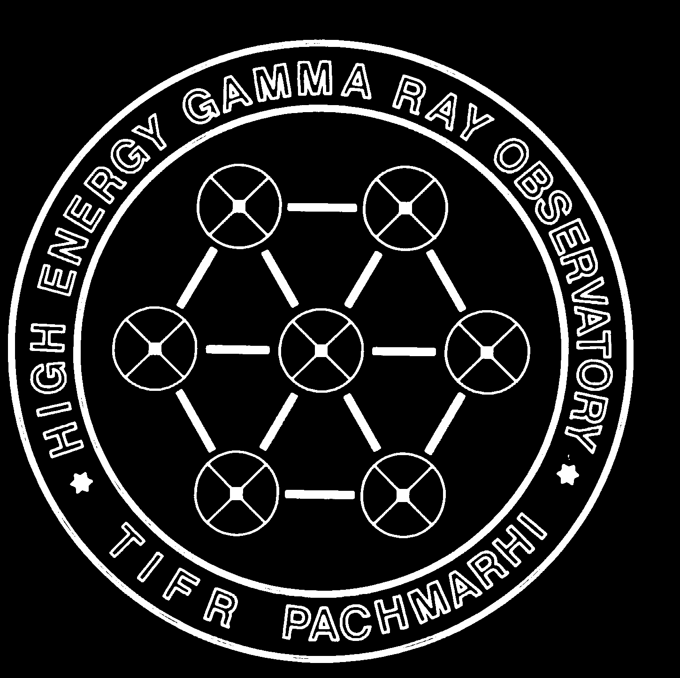
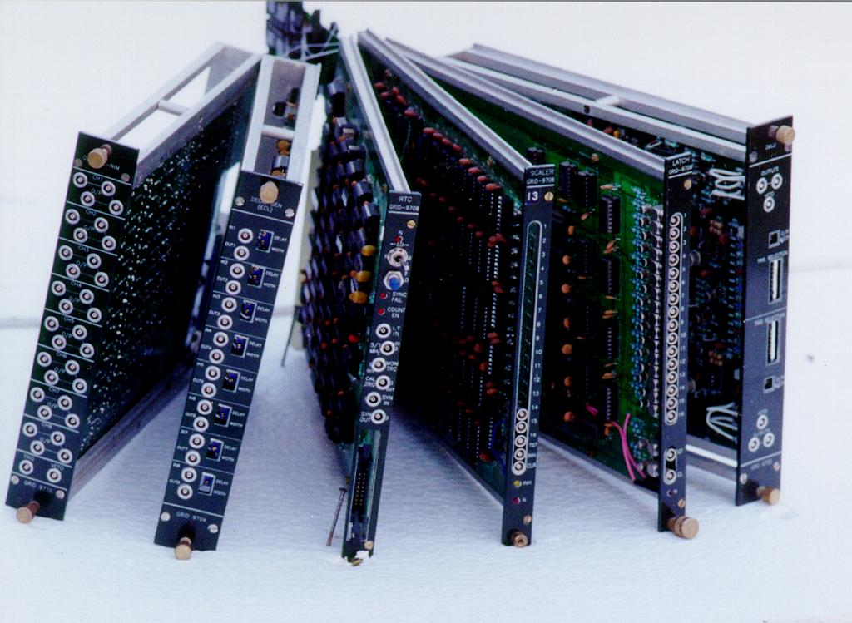
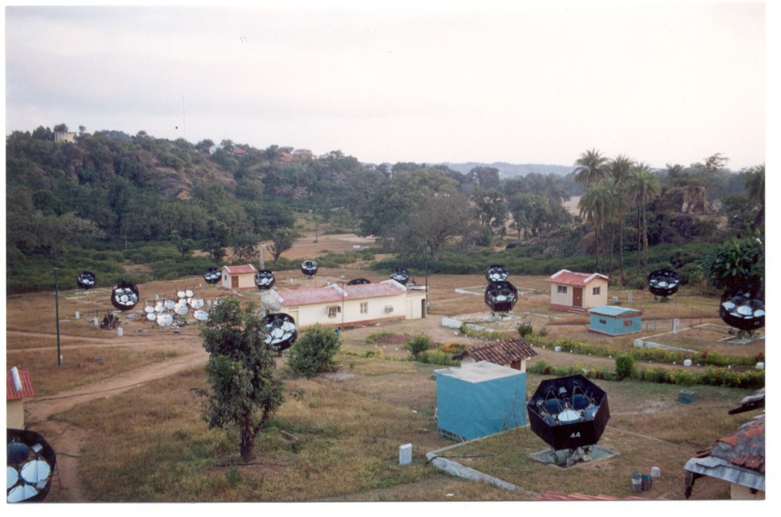

Slide 25
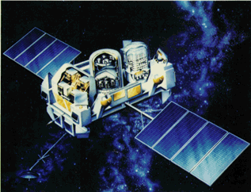
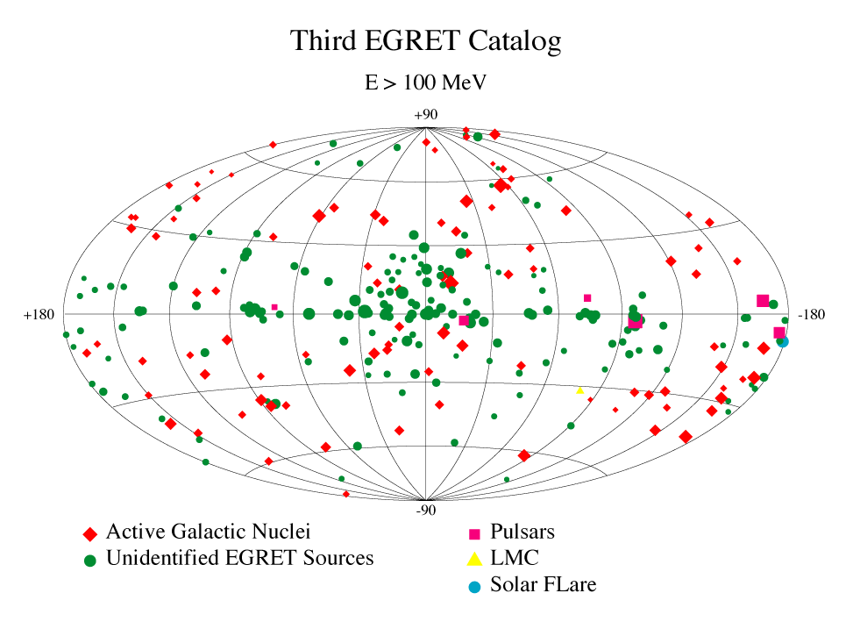
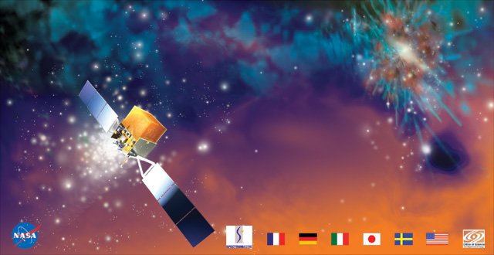
EGRET sky (1991-2000) - 270 sources
GLAST : 10 Mev to 300 GeV
Launched in June 2008

Slide 26
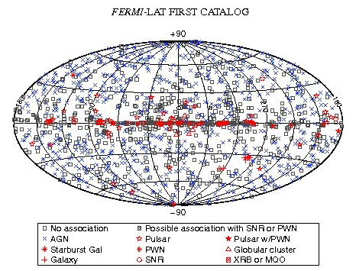

Slide 27
Why push to lower energy threshold?
The EGRET experiment, which has given a wealth of data below 10 GeV, has detected about 270 sources. On the other hand the atmospheric Cherenkov experiments have detected much fewer sources at >200 GeV. A good number of sources detected by EGRET are AGNs. Of these AGNs, those with large redshifts (far away galaxies) have not been detected by ground based experiments. This could be due to either a cutoff in the emission spectrum at the source itself or attenuation of gamma rays by the intervening IR background radiation. But such a cutoff due to attenuation of gamma rays by IR background radiation is not expected for galactic sources like pulsars, SNRs etc. Therefore, the energy spectrum of most of these objects must steepen in the energy range 10 to 200 GeV. This energy region is also a viable energy region to study GRBs. The universe is more transparent at around 10 GeV and hence one may look deeper into space. It has been recently realized that many celestial sources of gamma rays should have dramatic change of behavior in the 10 to 200 GeV energy range. Thus, it is imparative to conduct experiments in this energy range for a full under standing of processes in these interesting celestial objects.

Slide 28
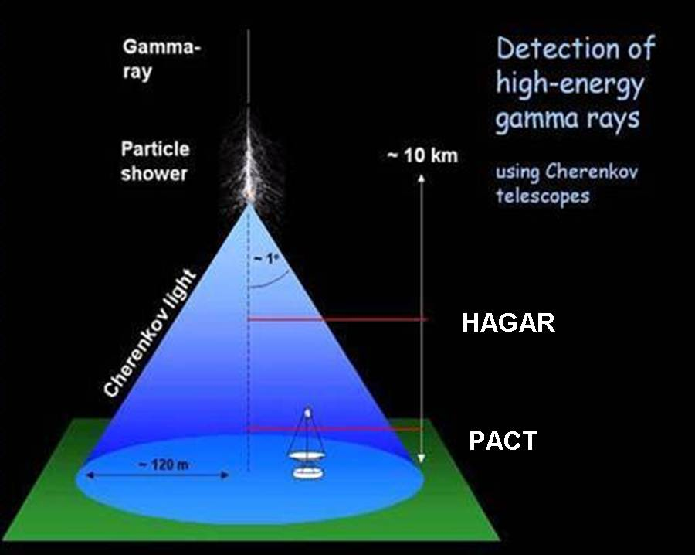
Gamma ray Astronomy : Atmospheric Cherenkov
experiment at high altitude in the Himalayas
Higher Cherenkov photon
density at higher altitude
Lower atmospheric
attenuation of Cherenkov
photons
Lower energy threshold
at higher altitudes
Interesting physics issues:
more sources can be observed,
cutoffs in spectra of Active Galactic
Nuclei, pulsars
Overlapping observations with FERMI
Phase 1: HAGAR (IIA+TIFR) 7 element WS
array (non-imaging);
Now operating
Phase 2: 21 m Dia MACE (BARC) imaging Tel.
Expected in 2013
Phase 3: MACE-II Stereo imaging; 2014+

Slide 29

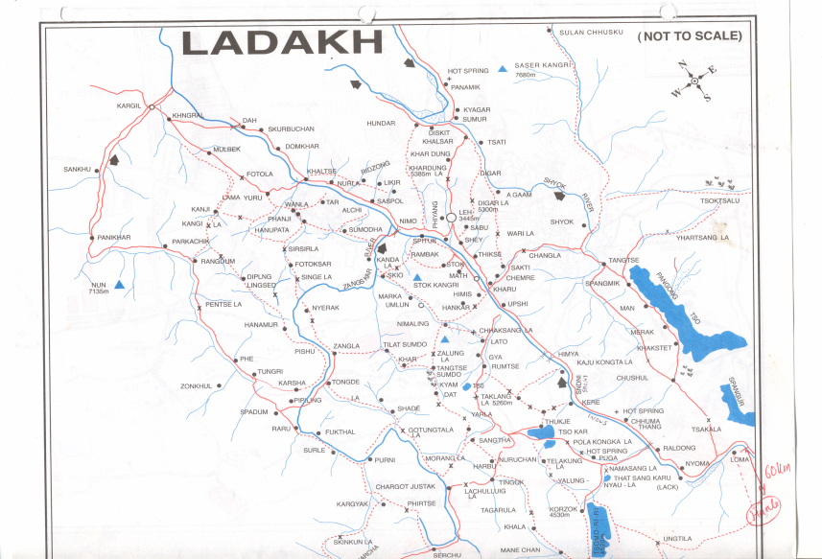
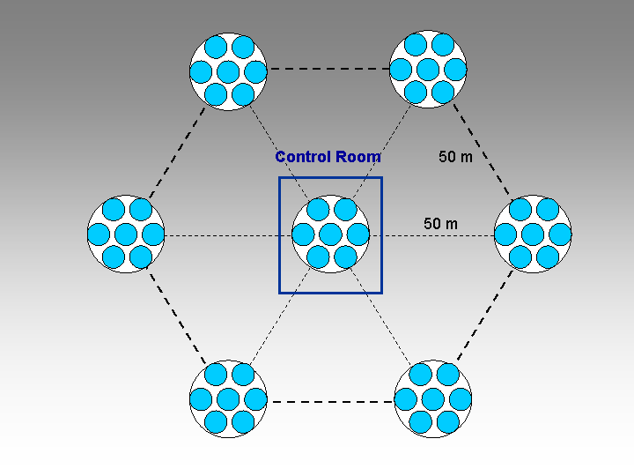
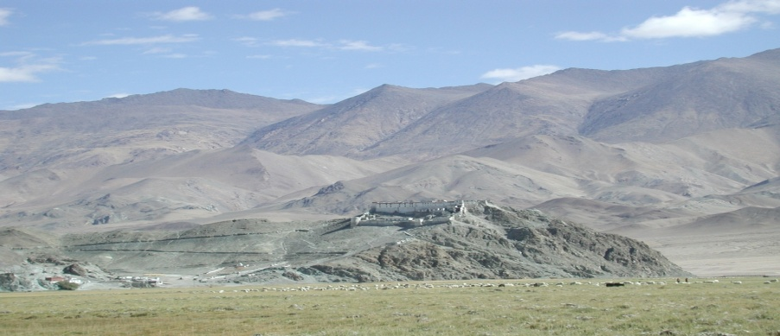
IAO, Hanle
Mt Abu
HEGRO, Pachmarhi
KGF
CRL, Ooty
Latitude: 32° 46΄ 46˝ N
Longitude : 78° 57΄ 51˝ E
Altitude : 4300 m

Slide 30
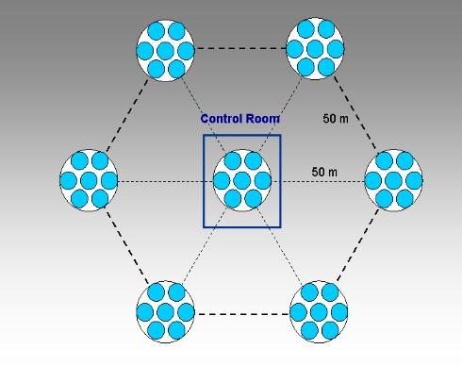
High Altitude GAmma Ray (HAGAR) Experiment
Experiment based on wavefront sampling technique
Located at Hanle base camp at altitude of 4300 m
Started as a collaboration between IIA and TIFR, but now part
of a larger collaboration : Himalayan Gamma Ray Observatory
(HiGRO) between BARC, IIA, SINP and TIFR +…..
Completely indigenously designed and assembled
Civil and mechanical : IIA, Optics and DAQ : TIFR
7 telescopes consisting of 7
para-axially mounted parabolic
mirrors of diameter 0.9 m
f/D ~ 1
Photonis UV sensitive
phototube (XP2268B)
at the focus of each mirror

Slide 31
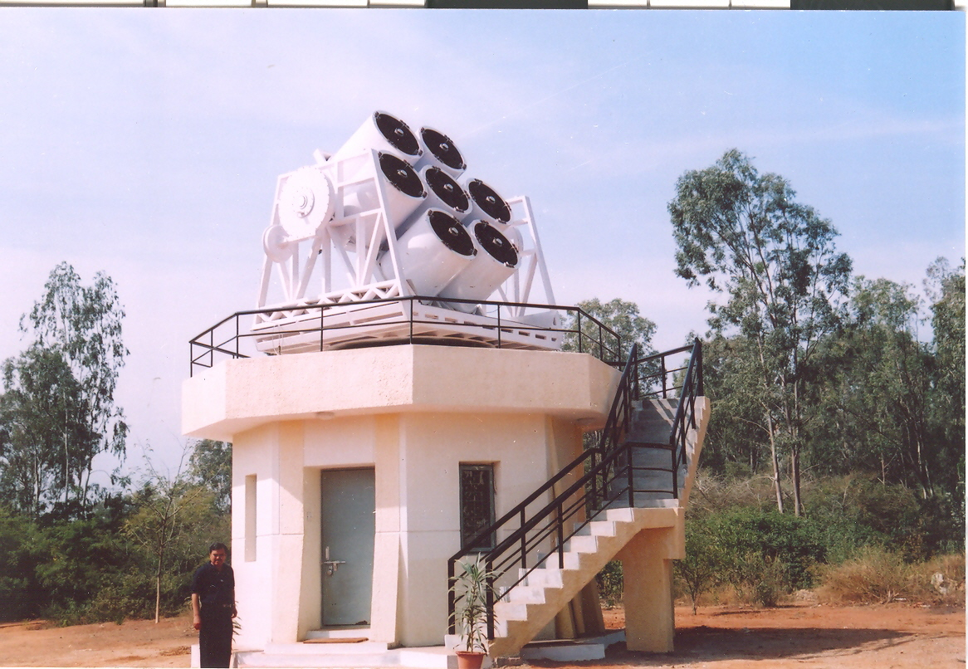

Two prototype telescopes by
– Bouving Foress
First telescope tested extensively
at CREST
2004-05

Slide 32




2005
First HAGAR Telescope at Hanle
7 telescopes consisting of 7 para-axially
mounted parabolic mirrors of diameter
0.9 m
f/D ~ 1
Front Coated 10mm thick glass mirrors
Total mirror area ~ 30 m²
Photonis UV sensitive phototube
(XP2268B) at the focus of each mirror

Slide 33

2006
Bouving
Foress
Avasarla Tech

Slide 34

HAGAR at Hanle
2007

Slide 35



2008
HAGAR at Hanle

Slide 36



Tracking System
Alt-Azimuth mount design
Steady-state pointing accuracy of servo of ∼10 arc-sec
Maximum slew rate of 36º/minute
Blind spot size while tracking stars near zenith ~1.2º
Maximum zenith angle coverage : 85º
Control software in Linux
Detailed point-run calibration by sighting large no. of stars to establish pointing model of the telescope.
rms pointing error within 1 arc minutes

Slide 37


Over all pointing accuracy ~ 0.1 degree
Angular resolution ~0.2 degree (Plane-front fit)
Scope for further improvement in pointing model and mirror alignment

Slide 38


Data acquisition and Telescope control

Slide 39



Sum of 7 PMT pulses
Flash ADC (Auqiris)
8 channel: 7 Tel + NSB
1GHz sampling
Telescope pulse

Slide 40


Expected Performance of HAGAR
Simulations of extensive air showers using CORSIKA
Detector Simulation: Site and instrument related parameters
Atmospheric attenuation of Cerenkov photons
Reflectivity of mirrors
Phototube response
Attenuation of pulse in coaxial cables
Discriminator thresholds
Trigger generation criteria
Collection area ~ 4x10⁴ m²

Slide 41

Sensitivity

Slide 42


Shower front is fitted
to plane front
Angular Resolution= 0.23 ± 0.09 degree

Slide 43


Slide 44

MACE gamma-ray telescopes
Phase II of HiGRO
21 m diameter basket
Energy threshold 20-40 GeV
Collection area –
~ few times 10⁵ m²
356 (1m x1m) diamond turned panels
total mirror area 337 m²
Mechanical structure 170 tons, 45 m high, 25 m dia
Camera : 1088 pixels covering FOV 4x 4 deg
Size : 2.23 m x 2.14 m x 1.327 m
Weight : 1200 kg
Expected energy threshold 20-30 GeV
Sensitivity : 5sigma detection of Crab in few minutes
Installation of MACE at Hanle expected in 2012
Science runs expected to commence in 2013
Koul et al. OG2.5 - 803

Slide 45



MACE gamma-ray telescopes
21 m diameter basket
Energy threshold 20-40 GeV

Slide 46

Status of Work on MACE
At Hanle :

Slide 47








Potential sources
GALACTIC
EXTRAGALACTIC
Supernova remnants
GRBs
AGNs
Pulsars
Origin & Acceleration of cosmic rays
Micro-quasars X-ray Binaries
AGNs
GRBs

Slide 48

Shell type Supernova Remnants

Slide 49




Crab
Current Status of Pulsar Search
MAGIC
E_{c}=17.7±2.8±5 GeV
E_{c}=8.8±1.1+2.9-1.1 GeV
Cutoff energy limits the height of emission (to avoid absorption)
to be beyond 4/6 stellar radius, which means polar cap model is ruled out

Slide 50

Results from HAGAR : Mkn421
Flaring activity in February, 2010
HAGAR observation period :
13 – 20 February, 2010
Total duration : 479 Minutes
 ray rate ~ 13.4 ± 1 /Minute
above 250 GeV
Significance : 12.7σ
Hint of correlated variability
in various bands
Amit Shukla et al. OG2.3 – 977 @ ICRC, Beijing

Slide 51

13-19 Feb, 2010
EPOCH1
EPOCH2
EPOCH3
EPOCH4

Slide 52




EPOCH2
EPOCH1
EPOCH3
EPOCH4

Slide 53


Epoch | Doppler factor | Magnetic field [G] | U_e [erg/cc] | Log E_min [eV] | Log E_max [eV] | E_break [eV] | P1 | P2
Epoch 1 | 20 | 0.027 | 0.9 x 10⁻³ | 9.2 | 12.1 | 11.3 | 2.2 | 4.6
Epoch2 | 26 | 0.019 | 0.66 x 10⁻³ | 8.7 | 12.1 | 11.45 | 2.2 | 4.0
Epoch3 | 25 | 0.018 | 0.6x 10⁻³ | 9.6 | 12.2 | 11.5 | 2.2 | 4.0
Epoch4 | 23 | 0.027 | 0.9 x 10⁻³ | 9.0 | 12.1 | 11.5 | 2.4 | 4.3
Avg MAGIC | 21 | 0.038 | 1.16 x 10⁻³ | 8.6 | 13.6 | 11.3 | 2.2 | 4.7

Slide 54


image of M87 with
Hubble Space Telescope
Active Galactic Nuclei

Slide 55
See T.C.Weekes, Nature V-448, 16-Aug-2007, p-760 & Aharonian et al, ApJ 664(2007)L-71

Slide 56
Summary
There are many open problems in high energy astrophysics that remain to be solved
Several large scale experiments are going on in the world , exploiting all features of the extensive air showers (some more expts. are planned)
Some facilities within our country are available for research in the filed of cosmic rays, gamma ray astronomy & neutrino physics.

Slide 57

Pachmarhi
Thanks !

