Slide 1
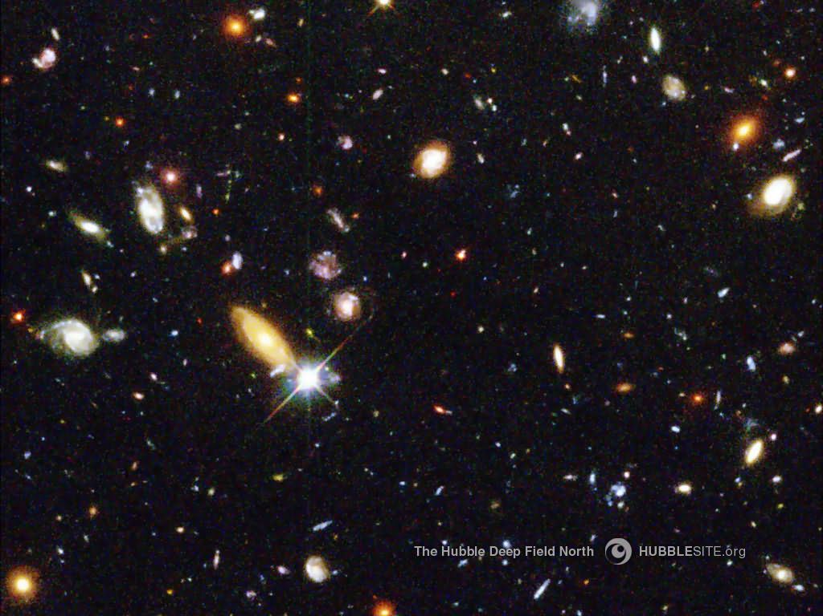
Introduction to
Big Bang Cosmology
Hang Bae Kim (Hanyang Univ.)
WAPP 2011, Darjeeling, India

Slide 2
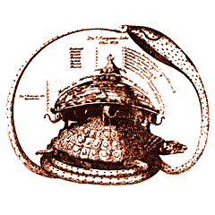
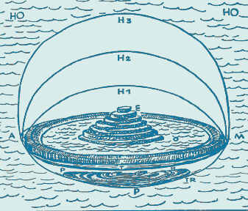
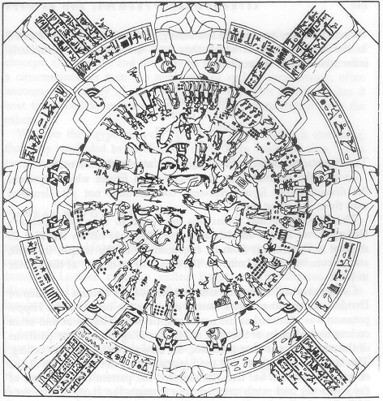
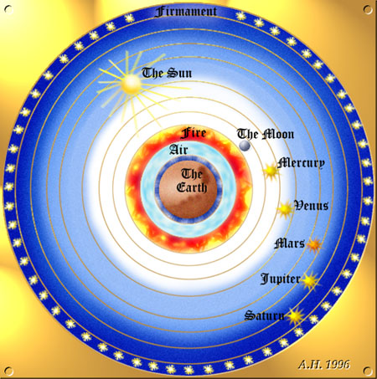
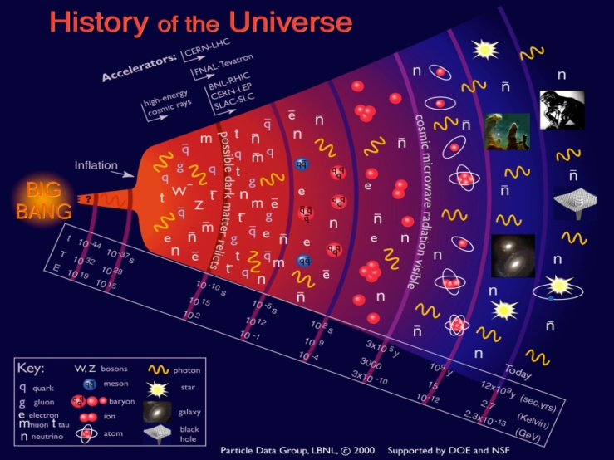
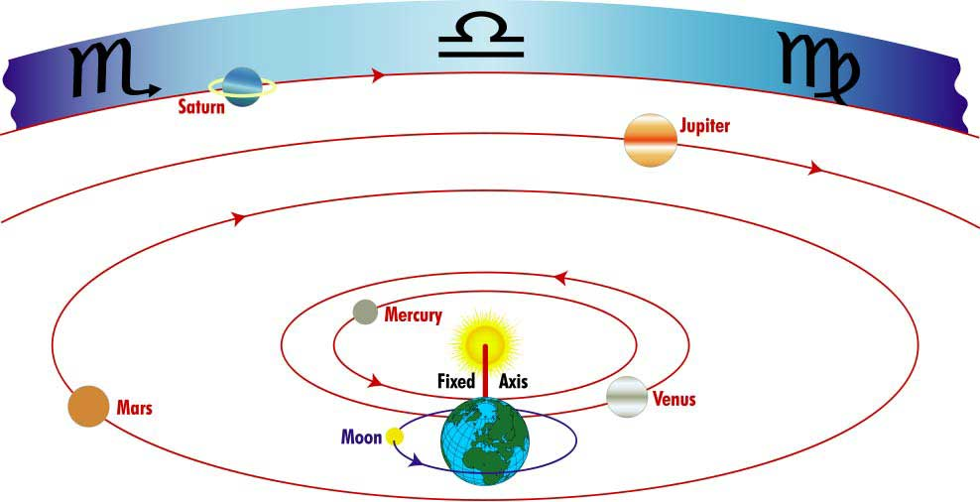
How the world is shaped?
India
Mesopotamia
Egypt
Greece-Rome
17th C, Western
Modern

Slide 3
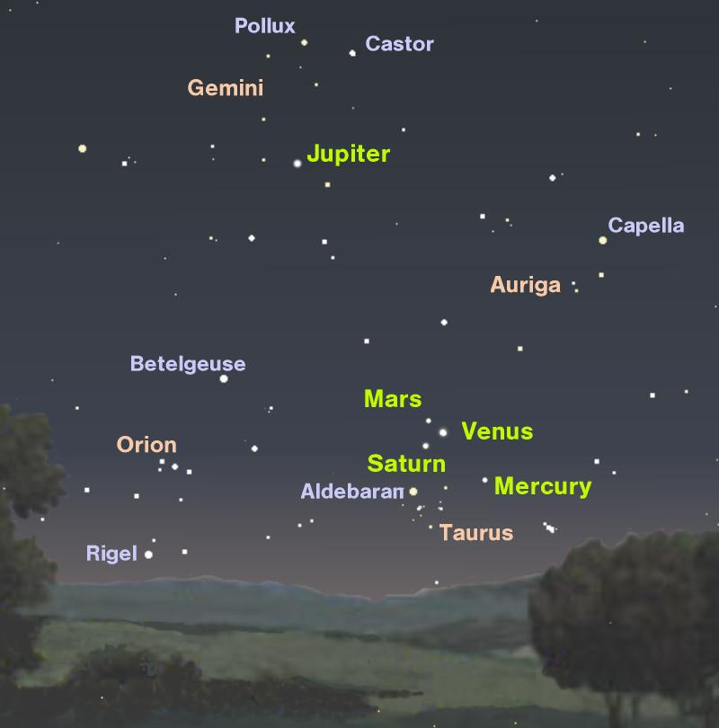
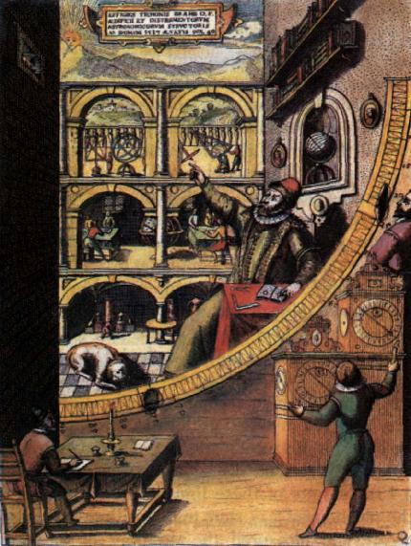
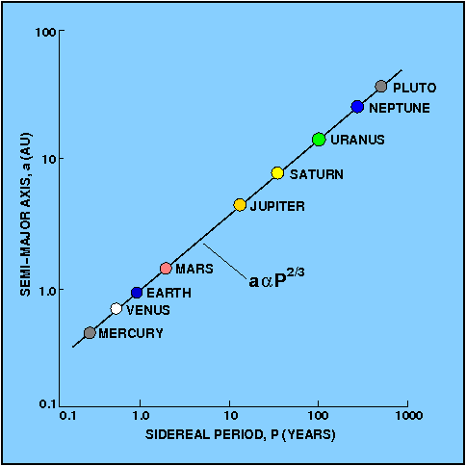

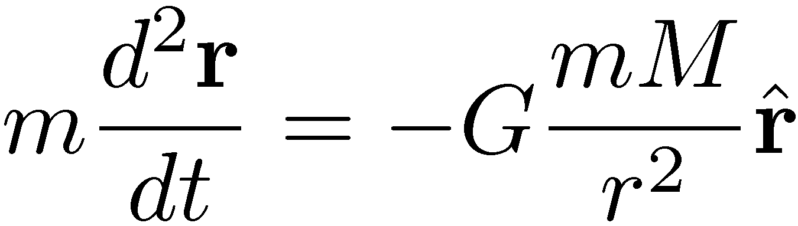
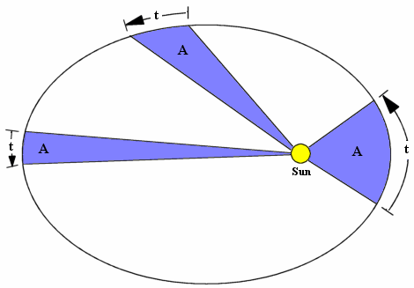
Understanding of the universe a success story
5 planets in the night sky
Tycho’s observation
Newton’s law of motion and gravitation
Kepler’s Laws
Compete understanding of planetary motion

Slide 4
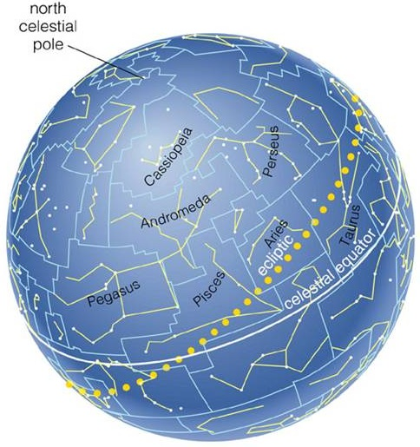
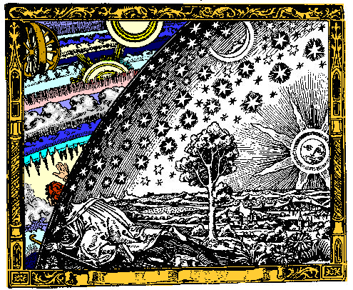
Stars and celestial sphere
Ancient people could not guess the distance to stars. They thought all stars reside on the celestial sphere.

Slide 5
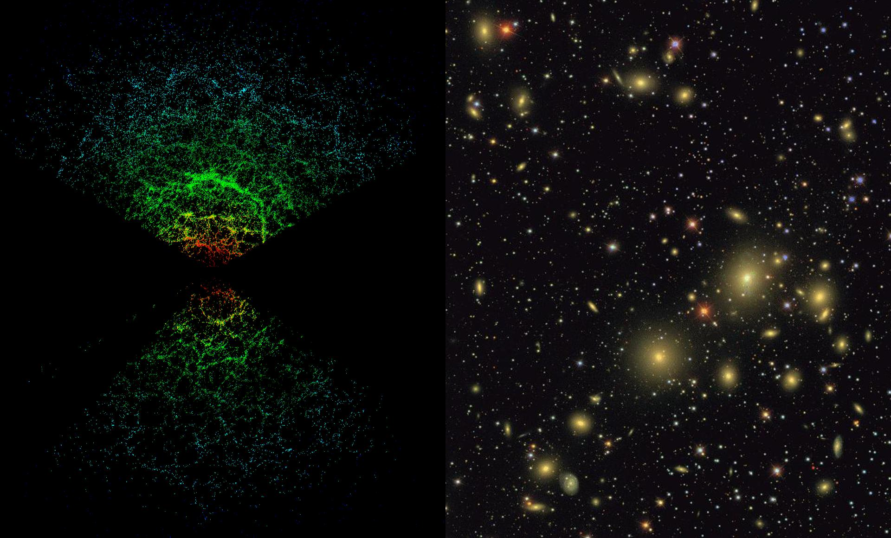
The shape of our universe from galaxy distribution
(Relatively) Small Scales - Structures
Large Scales - Homogeneous
Galaxy map
Hubble Deep Field

Slide 6
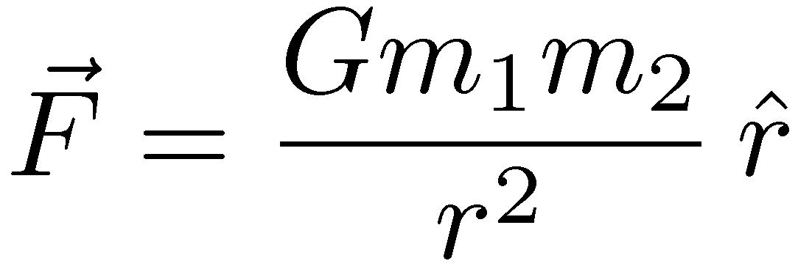
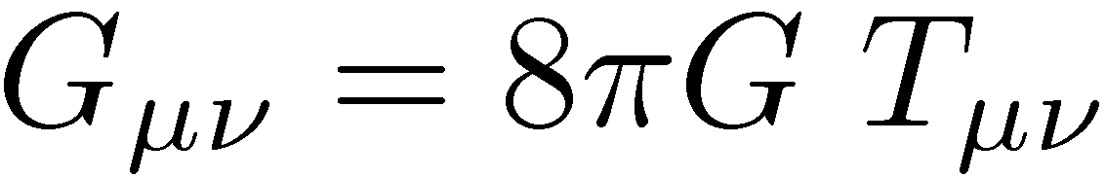
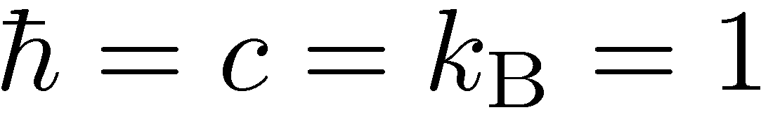

General Relativity
Comparison of Newton’s gravity and Einstein’s gravity
Newton’s Gravity | Einstein’s Gravity
Mass → Force | Matter → Geometry
Basic Units
Natural unit
Planck mass
Solar mass
parsec

Slide 7
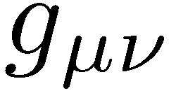
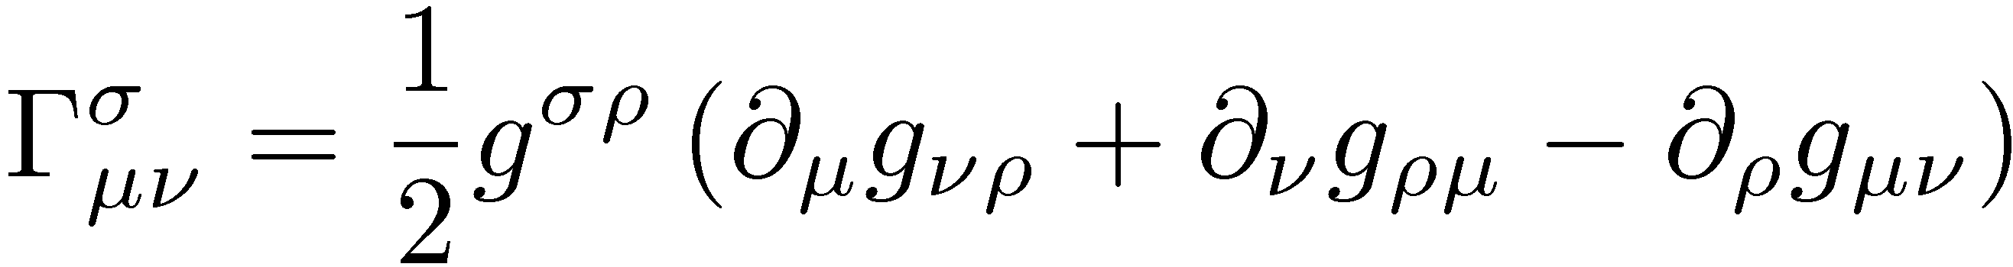
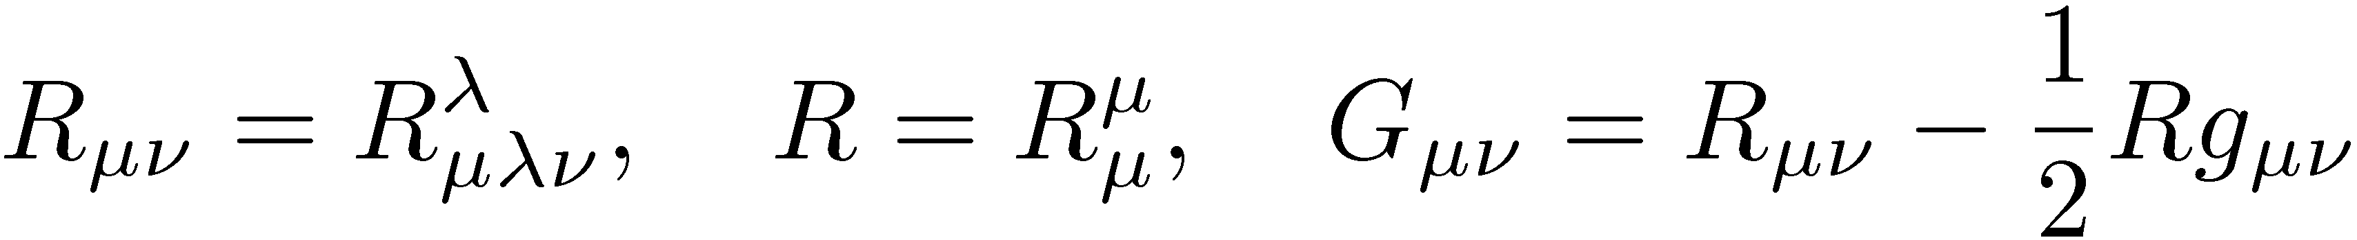
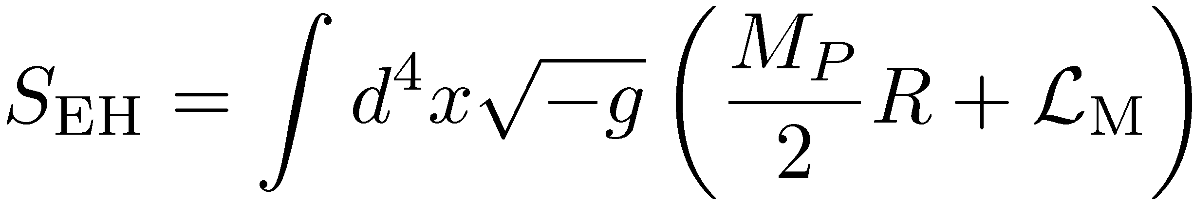
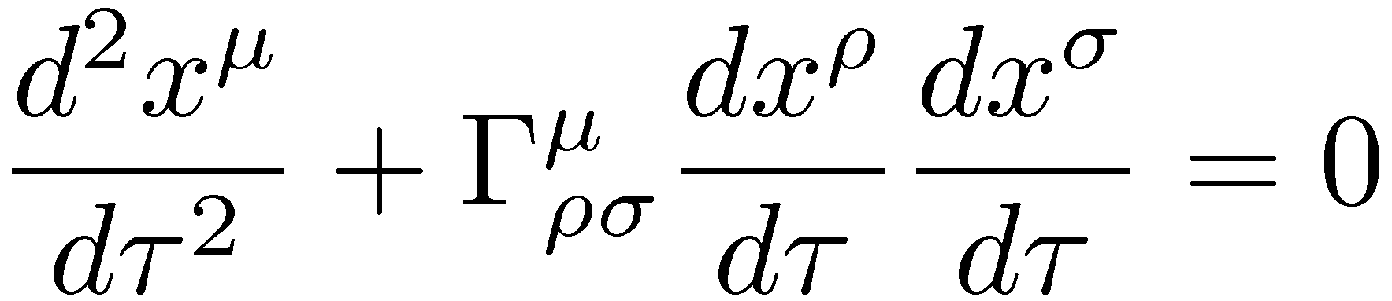
Most of cosmology can be learned with only a passing knowledge of general relativity : metric, geodesics, Einstein equation, …
metric
connection
curvature
Ricci and
Einstein tensor
Einstein equation can be derived from the Einstein-Hilbert action.
Geodesic equation – path of a freely falling particle
isometry
Symmetry of manifold ⇔ Killing vector
Maximally symmetric space

Slide 8

FRW Universe
Cosmological principle
  The universe is pretty much the same everywhere.
Observational facts
  The distribution of matter (galaxies) and radiation (CMB) in the observable universe is homogeneous and isotropic.
  The universe is not static : Distant galaxies are receding.
Robertson-Walker metric
Our local Hubble volume during Hubble time
~ spacetime with homogeneous and isotropic spatial sections
time
3D, maximally symmetric space

Slide 9
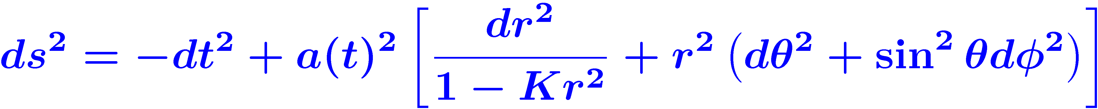
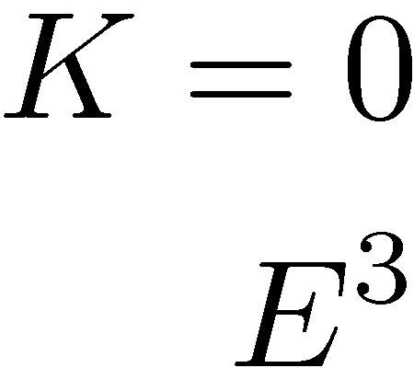
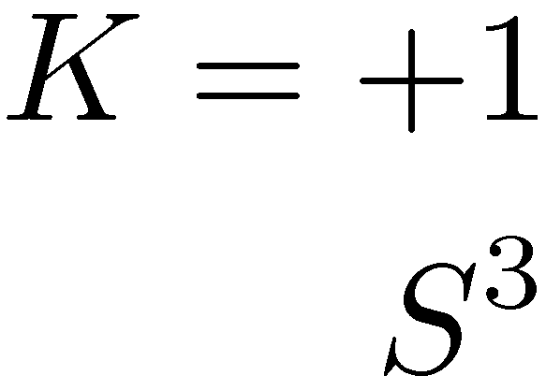
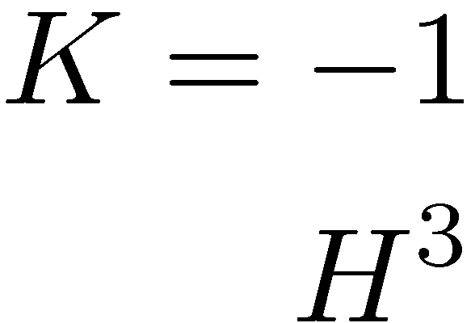
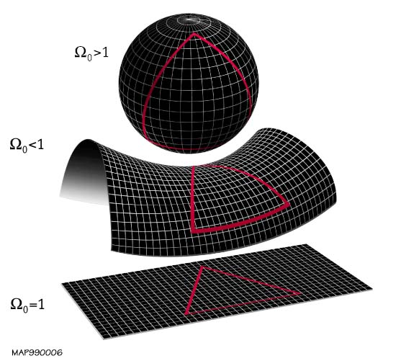



Scale factor, the only dynamical variable
2D examples of maximally symmetric space
Change of Scale factor

Slide 10
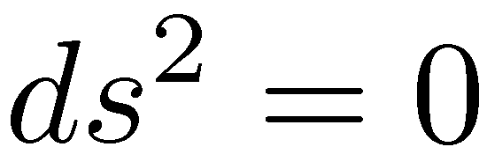
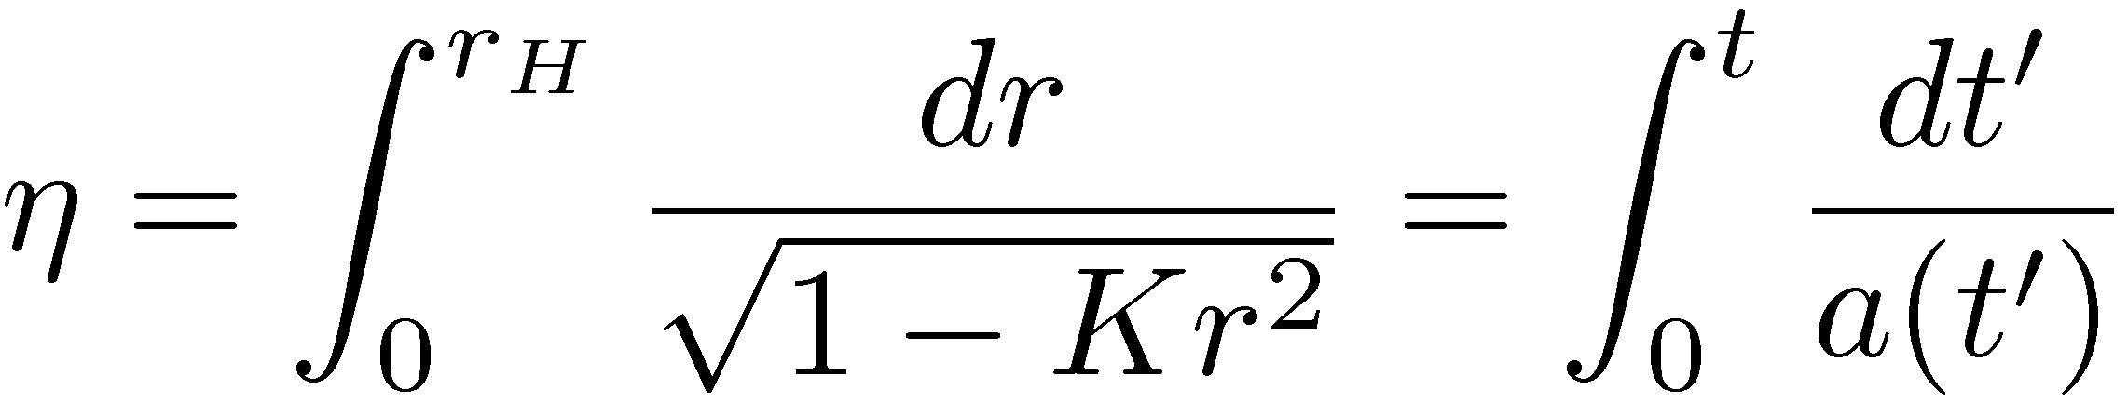
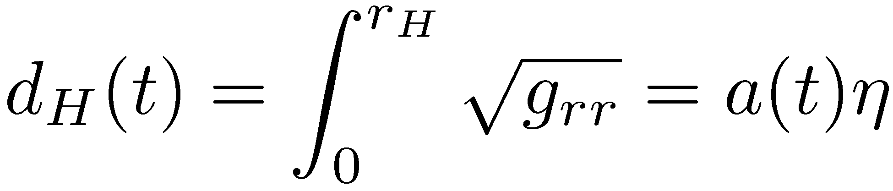
Kinematics of RW metric
Distances
Measuring distance in the expanding universe is tricky.
Comoving distance – fixed coordinate distance
Physical distance – comoving distance x scale factor
Luminosity distance
Angular diameter distance
Particle horizon
Consider the light propagation :
Total comoving distance light have traveled since t=0
No information could have propagated further than this.
⇒ comoving horizon
Physical distance to the horizon

Slide 11
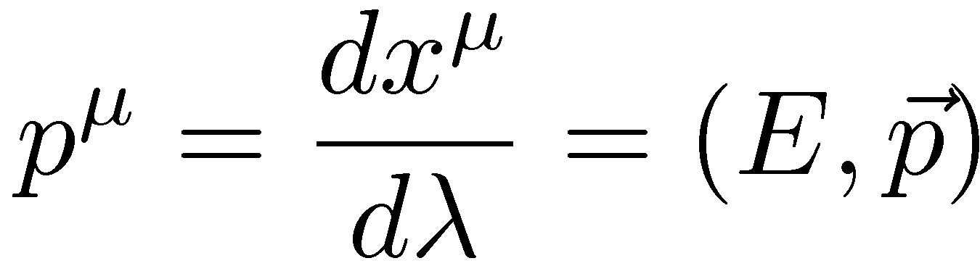
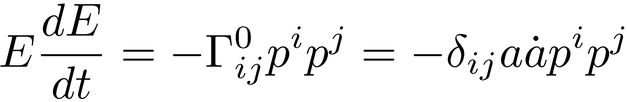
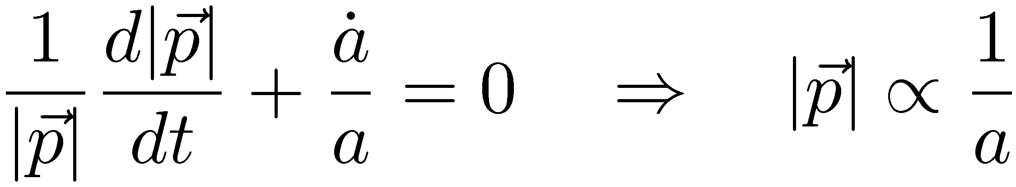
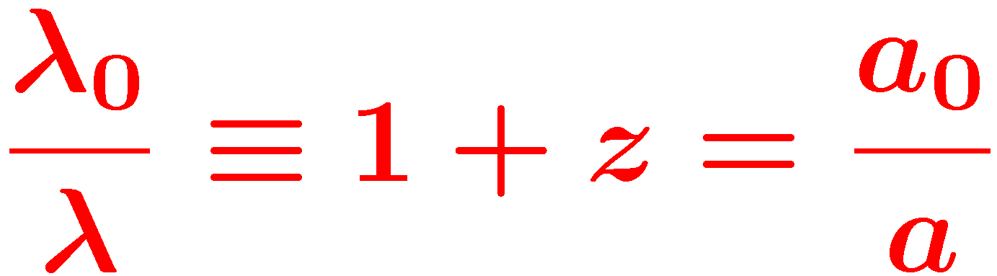
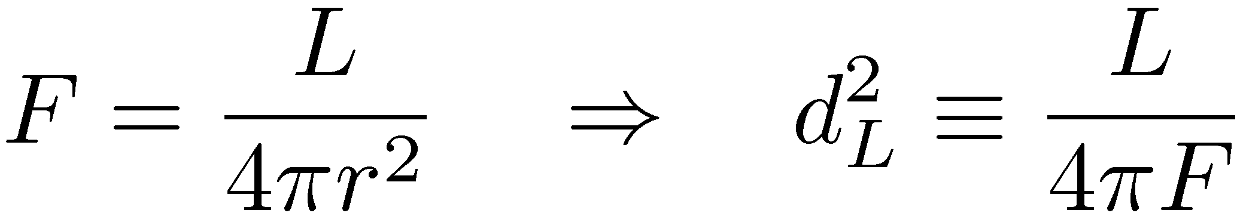
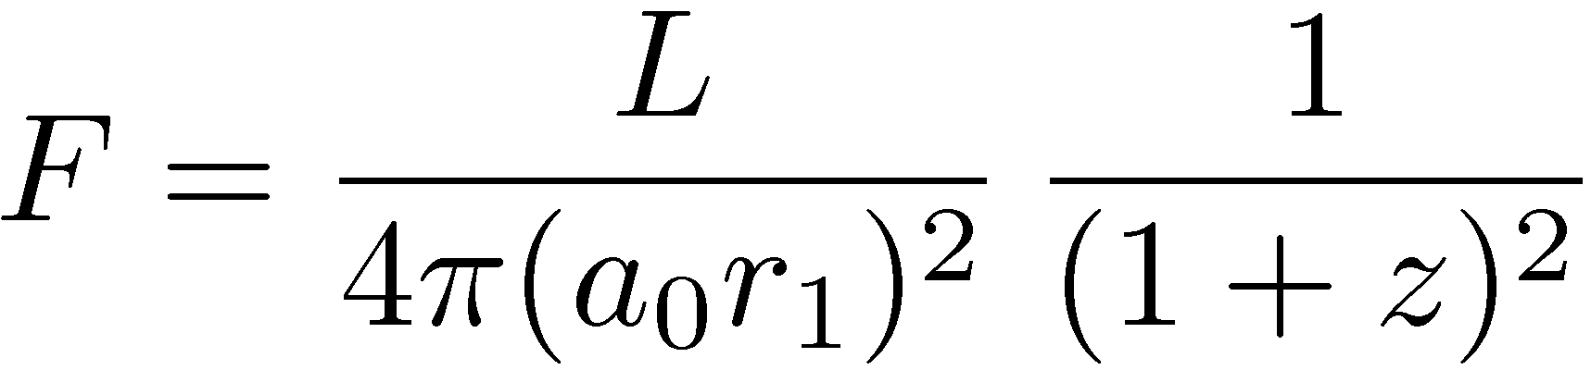
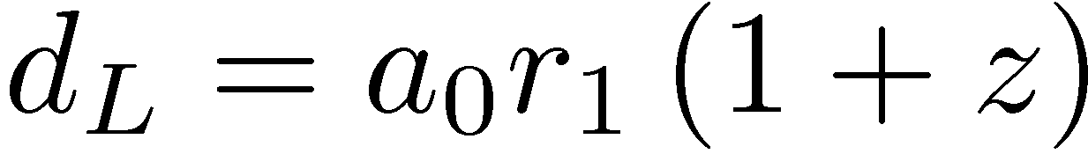
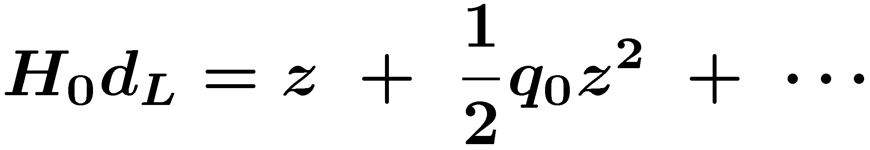
Freely falling particle - geodesic equation
Energy-momentum vector
0-component of geodesic eq.
Red shift parameter
Momentum red shift
as the scale factor increase
Hubble’s law
Luminosity distance
Effect of expansion

Slide 12
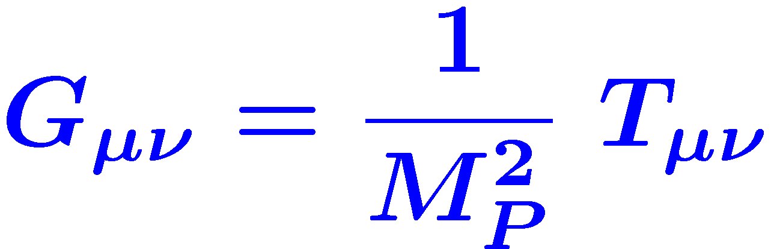
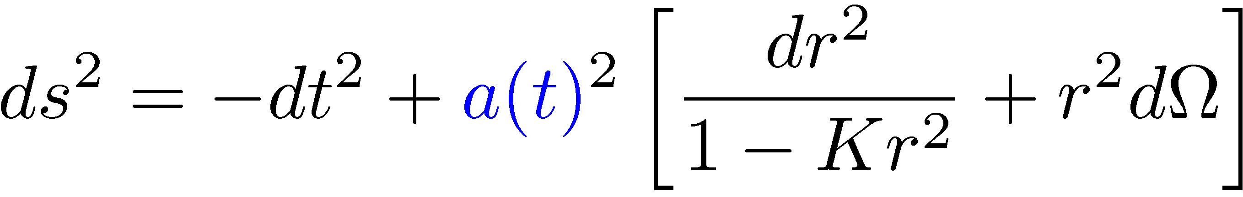
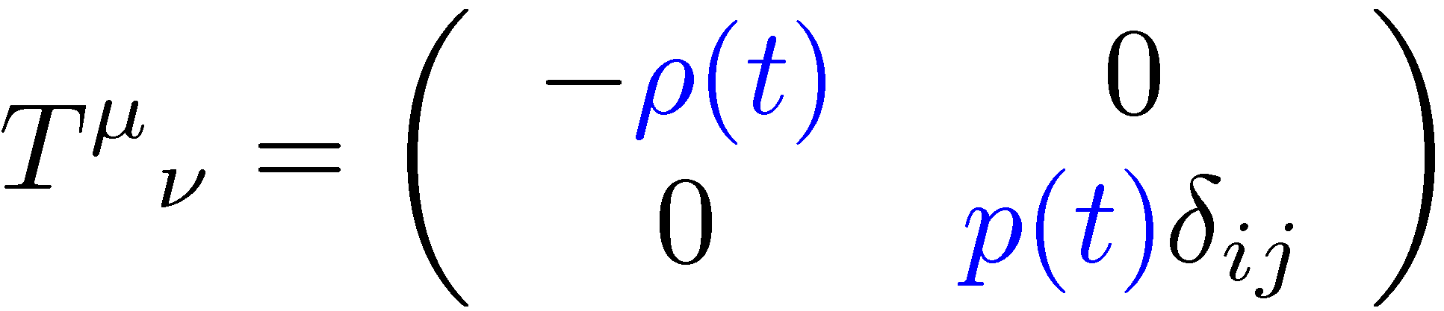
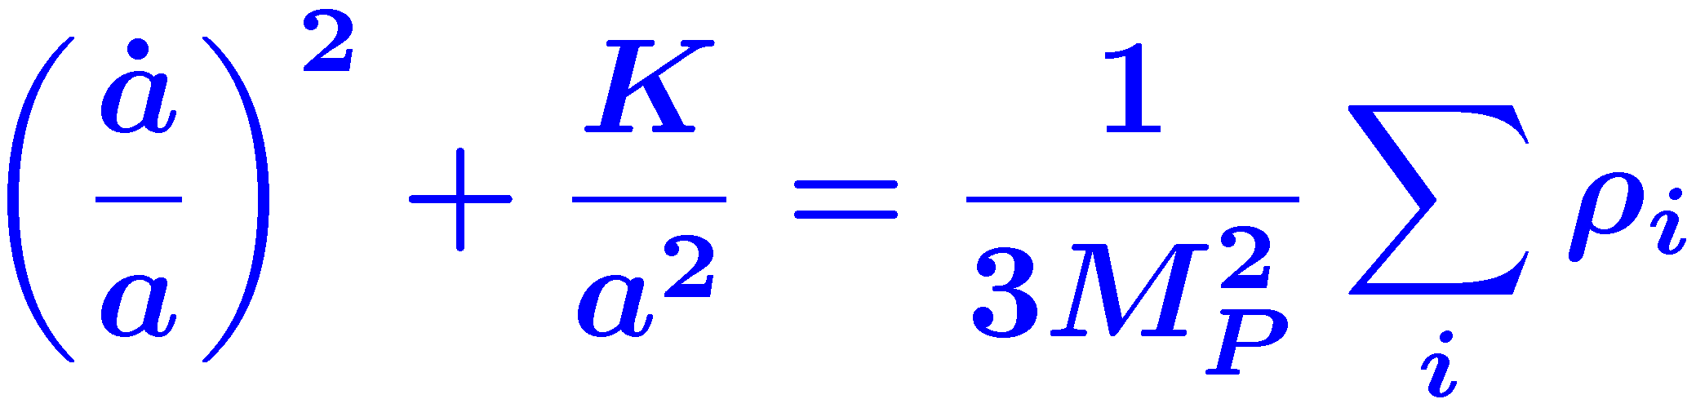
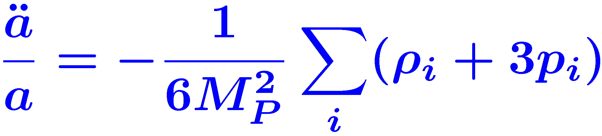
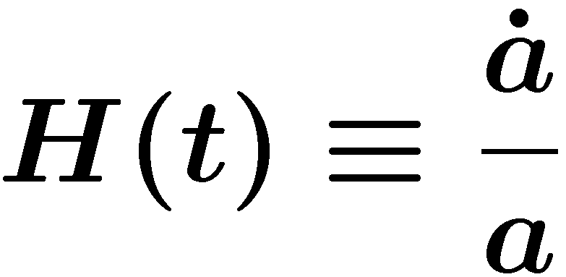
Dynamics of the universe
How is the evolution of the universe determined?
Friedmann equation
Einstein equation :
Geometry of our universe
Matter distribution
Scale Factor
Energy density
pressure
Hubble parameter
Expansion rate
Pressure also gravitates.

Slide 13
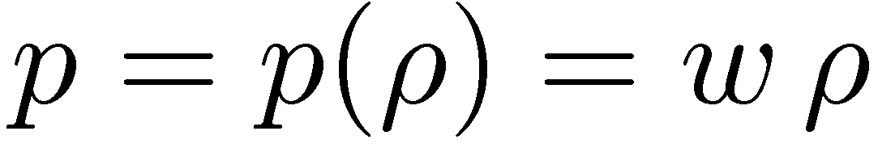
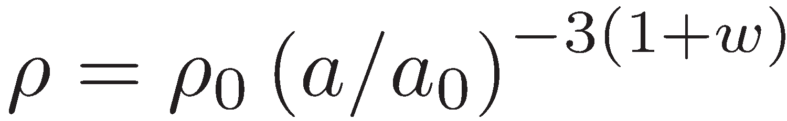




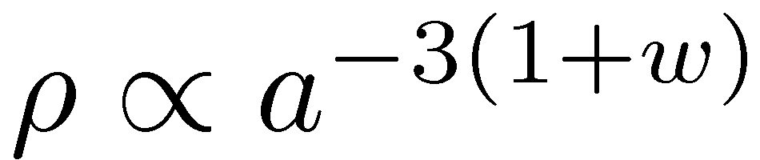
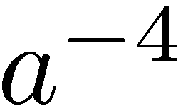
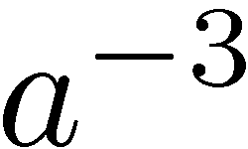






Evolution of the scale factor is determined by the matter content.
  Einstein Eq. : Geometry ↔ Matter distribution
  Friedmann eq. : scale factor chagne ↔ matter species, amount
Species – equation of state (relation of energy density(ρ) and pressure(p)
Simple form of eq. of state :
Name |  | Radiation | Matter | Vacuum E
Eq. of state
Energy density
Scale Factor
Amount – Density parameter, ratio to the critical density
    The critical density is determined by the Hubble constant.
    Roughly, 6 protons per 1m³

Slide 14




Solving Friedmann eq.
⇒ the motion of a particle with E=0 under the potential V(a)

Slide 15

Expansion history of the universe depends on the species and amounts of matter in the universe.
closed
open
flat

Slide 16



Discovery of Expansion
Redshift
  Vesto Slipher discovered the redshift of nebula (1912)
  Absorption spectra from distant galaxies are redshifted.
  Interpretation – Distant galaxies are receding from us.
Evidence for the expansion
  Redshift proportional to distance
  (Hubble’s law, 1929)
Edwin Hubble discovered that redshift is proportional to distance by observing Cepheid variables in distant galaxies.
Meaning of expansion – Dynamic universe
  Static universe : eternal, no expansion.
  Dynamic universe : beginning and end, changes.
  Steady state universe : expanding but no changes.
Our universe has the beginning.
  If we trace back the expansion history, we meet a singular (infinite energy density) point of a=0 in a finite time.
Big Bang

Slide 17






Einstein’s Biggest Blunder
  Introduced the cosmological constant to obtain the static universe (1917)
the biggest blunder of my life …
Fine tuning of Ω_{Μ} and Ω¤ can give|
a static (a=constant) solution.
  Gave up the static universe after Hubble’s discovery of expansion (1929)
  Resurrection of CC to explain the accelerating expansion (1998)

Slide 18




Discovery of CMB
Matter content of the universe - Radiation
  Eq. of state (Ideal gas of photons)
  Cosmic Microwave Background Radiation (CMB)
    George Gamow and Ralph Alpher’s prediction (1948)
    Arno Penzias and Robert Wilson’s discovery (1965)
    Very isotropic, perfect black body spectrum with T=2.73 K
Penzias and Wilson, and the antenna they used in the discovery of CMB
CMB is very isotropic. (δT/T~10⁻⁵ )

Slide 19


Consequences of Expansion
Meaning of the existence of CMB
  Black body spectrum of 2.73K
  ⇒ Our universe was in thermal equilibrium
  in the past.
Relation between the scale factor and the temperature in thermal equilibrium
Temperature and expansion
  small a in the past → high T in the past.
  Hot Big Bang : Our universe started in thermal equilibrium with high temperature.
High Temperature (T) ⬄ High Energy (E)
⬄ Short Distance (quantum principle)
  To understand the high temperature state of the early universe, we need the knowledge at short distance (high energy, that is particle physics).

Slide 20







Particles in equilibrium
Direct evidence for thermal equilibrium in the early universe
CMB : isotropic, accurate black body spectrum
The early universe is filled with hot ideal gas in thermal equilibrium.
Energy density and pressure at T
Relativistic, non-degenerate :
Nonrelativistic :

Slide 21






Total energy density
In equilibrium, the energy density of non-relativistic species is exponentially smaller than that of relativistic species.
Entropy
The entropy in a comoving volume is conserved in thermal equilibrium.
Entropy in the early universe is dominated by relativistic species
Entropy density
Evolution of T
Since and , is a convenient quantity to represent the abundance of decoupled particle.

Slide 22



Remnants of expansion
Thermal equilibrium and its break-down
  To keep thermal equilibrium, the reaction rate must be larger than the expansion rate.
  As temperature goes down, the reaction rate decreases faster than the expansion rate and thermal equilibrium is broken.
  If thermal equilibrium is kept on, no remnant from the past can be found.
Out-of-equilibrium make the history of the universe.
  Baryogenesis, Big ban nucleosynthesis
  Decoupling of dark matter, neutrinos, cosmic background radiation
Cosmology is similar to archeology in the sense that it deduces the past from the remnants.
The expansion of the universe makes the history.

Slide 23




Thermal history of the universe
The universe has been very nearly in thermal equilibrium for much of its history.
Departure from thermal equilibrium makes fossil record of the universe.
Rule of thumb for thermal equilibrium
Rough understanding of decoupling of species
Interaction mediated by a massive gauge boson

Slide 24





Boltzmann eq. for annihilation
Boltzmann Eq. : The rate of abundance change
= the rate of production – the rate of elimination
Consider the particle 1 in a process 1 + 2 ↔ 3 + 4

Slide 25







Baryon Asymmetry
Matter content of the universe – Baryons
  Matter forming our body : Baryon(protons, neutron), lepton(electron)
  Stars, planets, dust, gas, … (Most baryons are in intergalactic gases.)
Baryon Asymmetry
  SM of particle physics – very symmetric in baryon and anti-baryon
  Our universe is dominated by baryons.
The amount of baryon in our universe
  Good agreement in required amounts from BBN and CMBA
    (4 baryons to 1 billion photons)

Slide 26





Big Bang Nucleosynthesis
  As the universe cools down, light nuclei are synthesized from protons and neutrons. (Heavy nuclei are produced in the process of star evolution.)
  BBN is one of supporting evidences of BBU, by explaining very well the ratios of light nuclei in our universe.
  The ratios depends on the amount of baryon and the expansion rate at the time of BBN. ⇒ Good probe of baryon amount in our universe

Slide 27



Baryogenesis
Baryogenesis
  In the beginning, the universe was baryon symmetric.
  Baryon asymmetry was produced in the early universe.
  Sakharov conditions
    B violation
    C & CP violation
    Out-of-equilibrium
Andrei Sakharov
Standard Model cannot make sufficient baryon asymmetry.
→ New theory is needed.
  SM satisfies all three conditions.
  But, CP violation is too small and
  out-of-equilibrium is not enough.

Slide 28



Decoupling of CBR
Decoupling of cosmic background radiation
  Equilibrium between protons, electron, hydrogen atoms, and photons (about 300,000 years after big bang)
  CMB we see today comes from
  the last scattering surface.
The Last Scattering Surface, an art installation
at the Henry Art Gallery on the University of
Washington campus in Seattle

Slide 29

Thermal History of the Universe

Slide 30







Large scale structures
Our universe is very homogeneous on huge scales.
Perfectly homogenous universe cannot explain the structures we see today, stars, galaxies, clusters, etc.
Without structures, we cannot explain our existence itself.
Galaxy: Andromeda
Cluster: Coma
Supercluster: Perseus
Earth Case
Structure of
the universe

Slide 31

Understanding the formation of structures
  Basic ideas : small primordial density perturbation Structures
  Detailed model :
Action of gravity
Initial density perturbation
Evolution
Large scale structures
Comparison with observation
- Spectral analysis
Origin of initial density perturbation?
Inflation
Topological defects
Observed facts
  Size of initial density perturbation 10⁻⁵
  Structure grows after matter domination.
  If matter consists solely of baryons, structures grows after photon decoupling. Not enough time for structures to grow.
  Cold Dark Matter is required.

Slide 32




Dark Matter
To explain the formation of LSS, dark matter is a necessity.
  The amount of dark matter in our universe :
Other evidences for dark matter
  Rotation curves of galaxies
  Gravitational lensing, mismatch in baryon and matter distribution
Gravitational lensing effect reveals the existence of matter unseen between far galaxies and us.
Rotation curve of galaxy shows the existence of dark matter outside the visible disk of galaxy.
Colliding clusters
Baryon(red, X-ray) and dark matter (blue, gravitational lensing) reside separately. Galaxies follow the dark matter distribution.

Slide 33



Dark matter decoupling
Generic WIMP scenario
heavy particle
light particle
tightly coupled to cosmic
plasma (in equilibrium)
weak interaction
Boltzmann eq.
No explicit mass dependence.
Relic abundance is mainly determined by cross section.

Slide 34

What is dark matter?
  LSP – Neutralino
  Axion
  Gravitino, Axino, LKK, …
  WIMP, WIMPzilla, …
Dark matter search
  Direct search
  Indirect search

Slide 35



CMB Anisotropies
Is there any other evidence for primordial density perturbation?
CMB Anisotropies (CMBA)
  Decoupling of CMB
  CMB we see today
  – from the last scattering surface
  Origin of CMBA
    Gravitational potential due to
    density perturbation of CDM
    Baryon Acoustic Oscillation
    - Oscillation of strongly coupled baryon-photon plasma
Observation of CMBA
2.73 K
1/1,000 K
1/100,000 K (COBE)

Slide 36


Discovery of the origin of
structures in the universe
Cosmology became
precise science.
CMBA contain much information about our universe.

Slide 37




Discovery of accelerating expansion
SN Ia observations
  Very bright, far distant one can be observed.
  Uniform luminosity,
  calibrated by light curve
Ia형 초신성 관측

Slide 38






Physical distance depends on geometry.
Red shift – luminosity distance relation
Distance modulus is frequently used instead of lum. distance.
Hubble’s law, Hubble Cons.
Deceleration parameter
Determined by species and amounts of matter.
Determine the age and the
size of the universe
For acceleration, matter with
must dominate.

Slide 39



Why is the expansion accelerating?
Option 1 – The energy density is dominated by Dark Energy.
What is dark energy?
  Negative pressure ( ) accelerates the expansion.
  No light (No interaction with ordinary matter)
Candidates for dark energy
  Vacuum energy (Cosmological constant)
  Slow-rolling scalar field - quintessence
Option 2 – Gravity deviates from GR at scales larger than galaxies.
Ex) DGP model (5D brane-world model)
5D gravity
Magic piece of DGP
Gives acceleration,
but with many other troubles …
Matter living on 4D brane

Slide 40



Slide 41

What is dark energy?
Vacuum energy density - Cosmological constant
Vacuum energy density also gravitates.
Slow-rolling scalar field has the property of DE.
Dynamical model
Assume that V.E is set to 0 by some reason.
Slow-rolling scalar field has the property of DE.
In QM, vacuum (ground state) is not a state of emptiness.
VC also gravitates.

Slide 42





Vacuum E. D. – Cos. Constant
Einstein, 1917 – Introduced Cosmological Constant
to get a static universe from GR
Zeldovich, 1968 – Identify C.C. as the V.E.D
Raise the C.C. problem
Can we calculate the vacuum energy density?
QFT : V.E.D is the sum of zero-point energy.
Energy cutoff
The highest E at which QFT holds
∞, 발산한다.
C.C. problem !
QFT prediction
Need for Quantum Gravity

Slide 43






Slow-rolling scalar
Dynamical model for dark energy
Dynamics of homogeneous scalar field
Merits of slow-rolling scalar field
Eq. of state that varies in time
Possibility to explain the present ratio of D.E. and D.M. densities.
Troubles of slow-rolling scalar field
The question why V.E.D is zero is still remained.
The mass of scalar is extremely small.

Slide 44


Matter content of the universe
We get precise composition of the energy density of the universe from many observations.

Slide 45

  Shortcomings of Big Bang
Why is our universe so flat and so homogenous?
  The flatness problem, the horizon problem
  Scale Factor ⇔ Horizon size
  The current Hubble volume was not causally connected in the past.
How was the initial density perturbations created?
  Density perturbations at large scales which were not causally connected cannot be created.
When and how was baryon asymmetry made?
What is dark matter and when it was created?
What is dark energy?
…
All problems are related to the initial state of the big bang universe.
Answer from cosmology or particle physics?

Slide 46

Inflation
What is inflation?
  Period during which the scale factor grows rapidly
  Inflation makes the universe flat and homogeneous.
  If the scale factor grows by more than e⁶⁰, the universe
  we see today becomes causally connected.
How does inflation occur?
  Big vacuum energy
  Slow rolling scalar field along flat potential
Inflation generates initial density perturbation.
  Quatum fluctuations δφ
  → density perturbations δρ
  Inflation explains our existence.
Transition from inflation to Hot Big Bang
  (re)heating process
How was inflation begun?
  Endless questions again…. ?

Slide 47


Understanding the universe
It seems that we understand our universe rather well …
But, we don’t know what are really
95% of the matter filling our universe

